Slide 1
Biometry:
A Step by Step Approach
Judith Simon MD
Tamale Teaching Hospital,
Dept of Surgery/
Ophthalmology

Slide 2
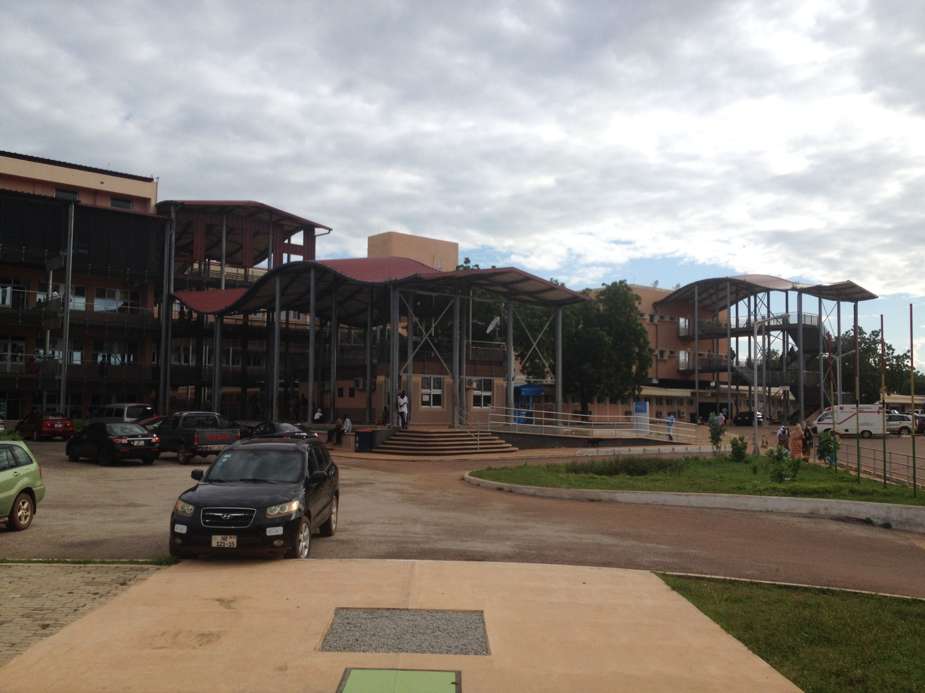
Tamale Teaching Hospital

Slide 3
What is it?
Measurement of the corneal power and the axial length of the eye
From these a computer calculates the power of the implant the patient needs to be emmetropic after surgery
Patients can be also made nearsighted upon request

Slide 4
Why is it necessary?
To improve uncorrected vision
In rural/poor urban setting: Eye glasses are not available and/or patients are not able to afford them
In private clinic setting: patient expectations are increasing, they demand good uncorrected vision

Slide 5
Why is it not done?
Lack of equipment, time, expertise, motivation, reimbursement
Need to keep an inventory of different power of IOLs – a bit cumbersome

Slide 6
But…
Without biometry about 1/3 of patients become either significantly myopic or hyperopic and will have poor uncorrected vision !!!
With minimal extra effort you can greatly improve outcomes!!!

Slide 7
Needed:
Instruments:
  Keratometer
  A-scan
Personnel:
  Optometrist
  Eye-nurse
  Can train laypeople – NOT difficult !

Slide 8
Keratometer
Manual (cheap)
Automatic, non-portable – usually combined with autorefractometer (expensive)
Automatic, portable - can be used in outreach and in pediatric cataract surgery
(expensive) – buy one working with regular batteries

Slide 9
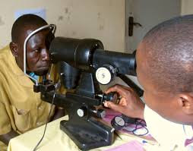
Manual keratometry

Slide 10
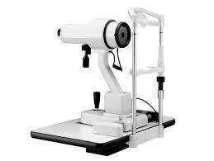
Keratometer

Slide 11
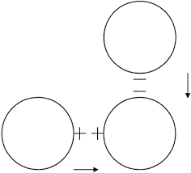
Align myers

Slide 12
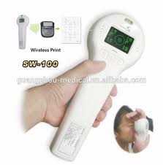
Portable keratometer

Slide 13
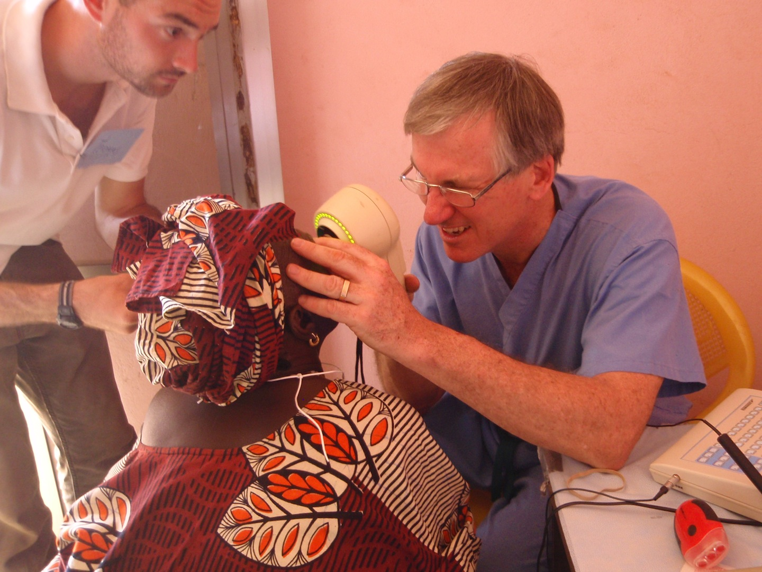
Portable keratometry

Slide 14
A-scan
Better to buy portable – can be used on outreaches, price is not different
Lasts for decades if well taken care of
Do not drop probe!
Needs trained personnel to use

Slide 15
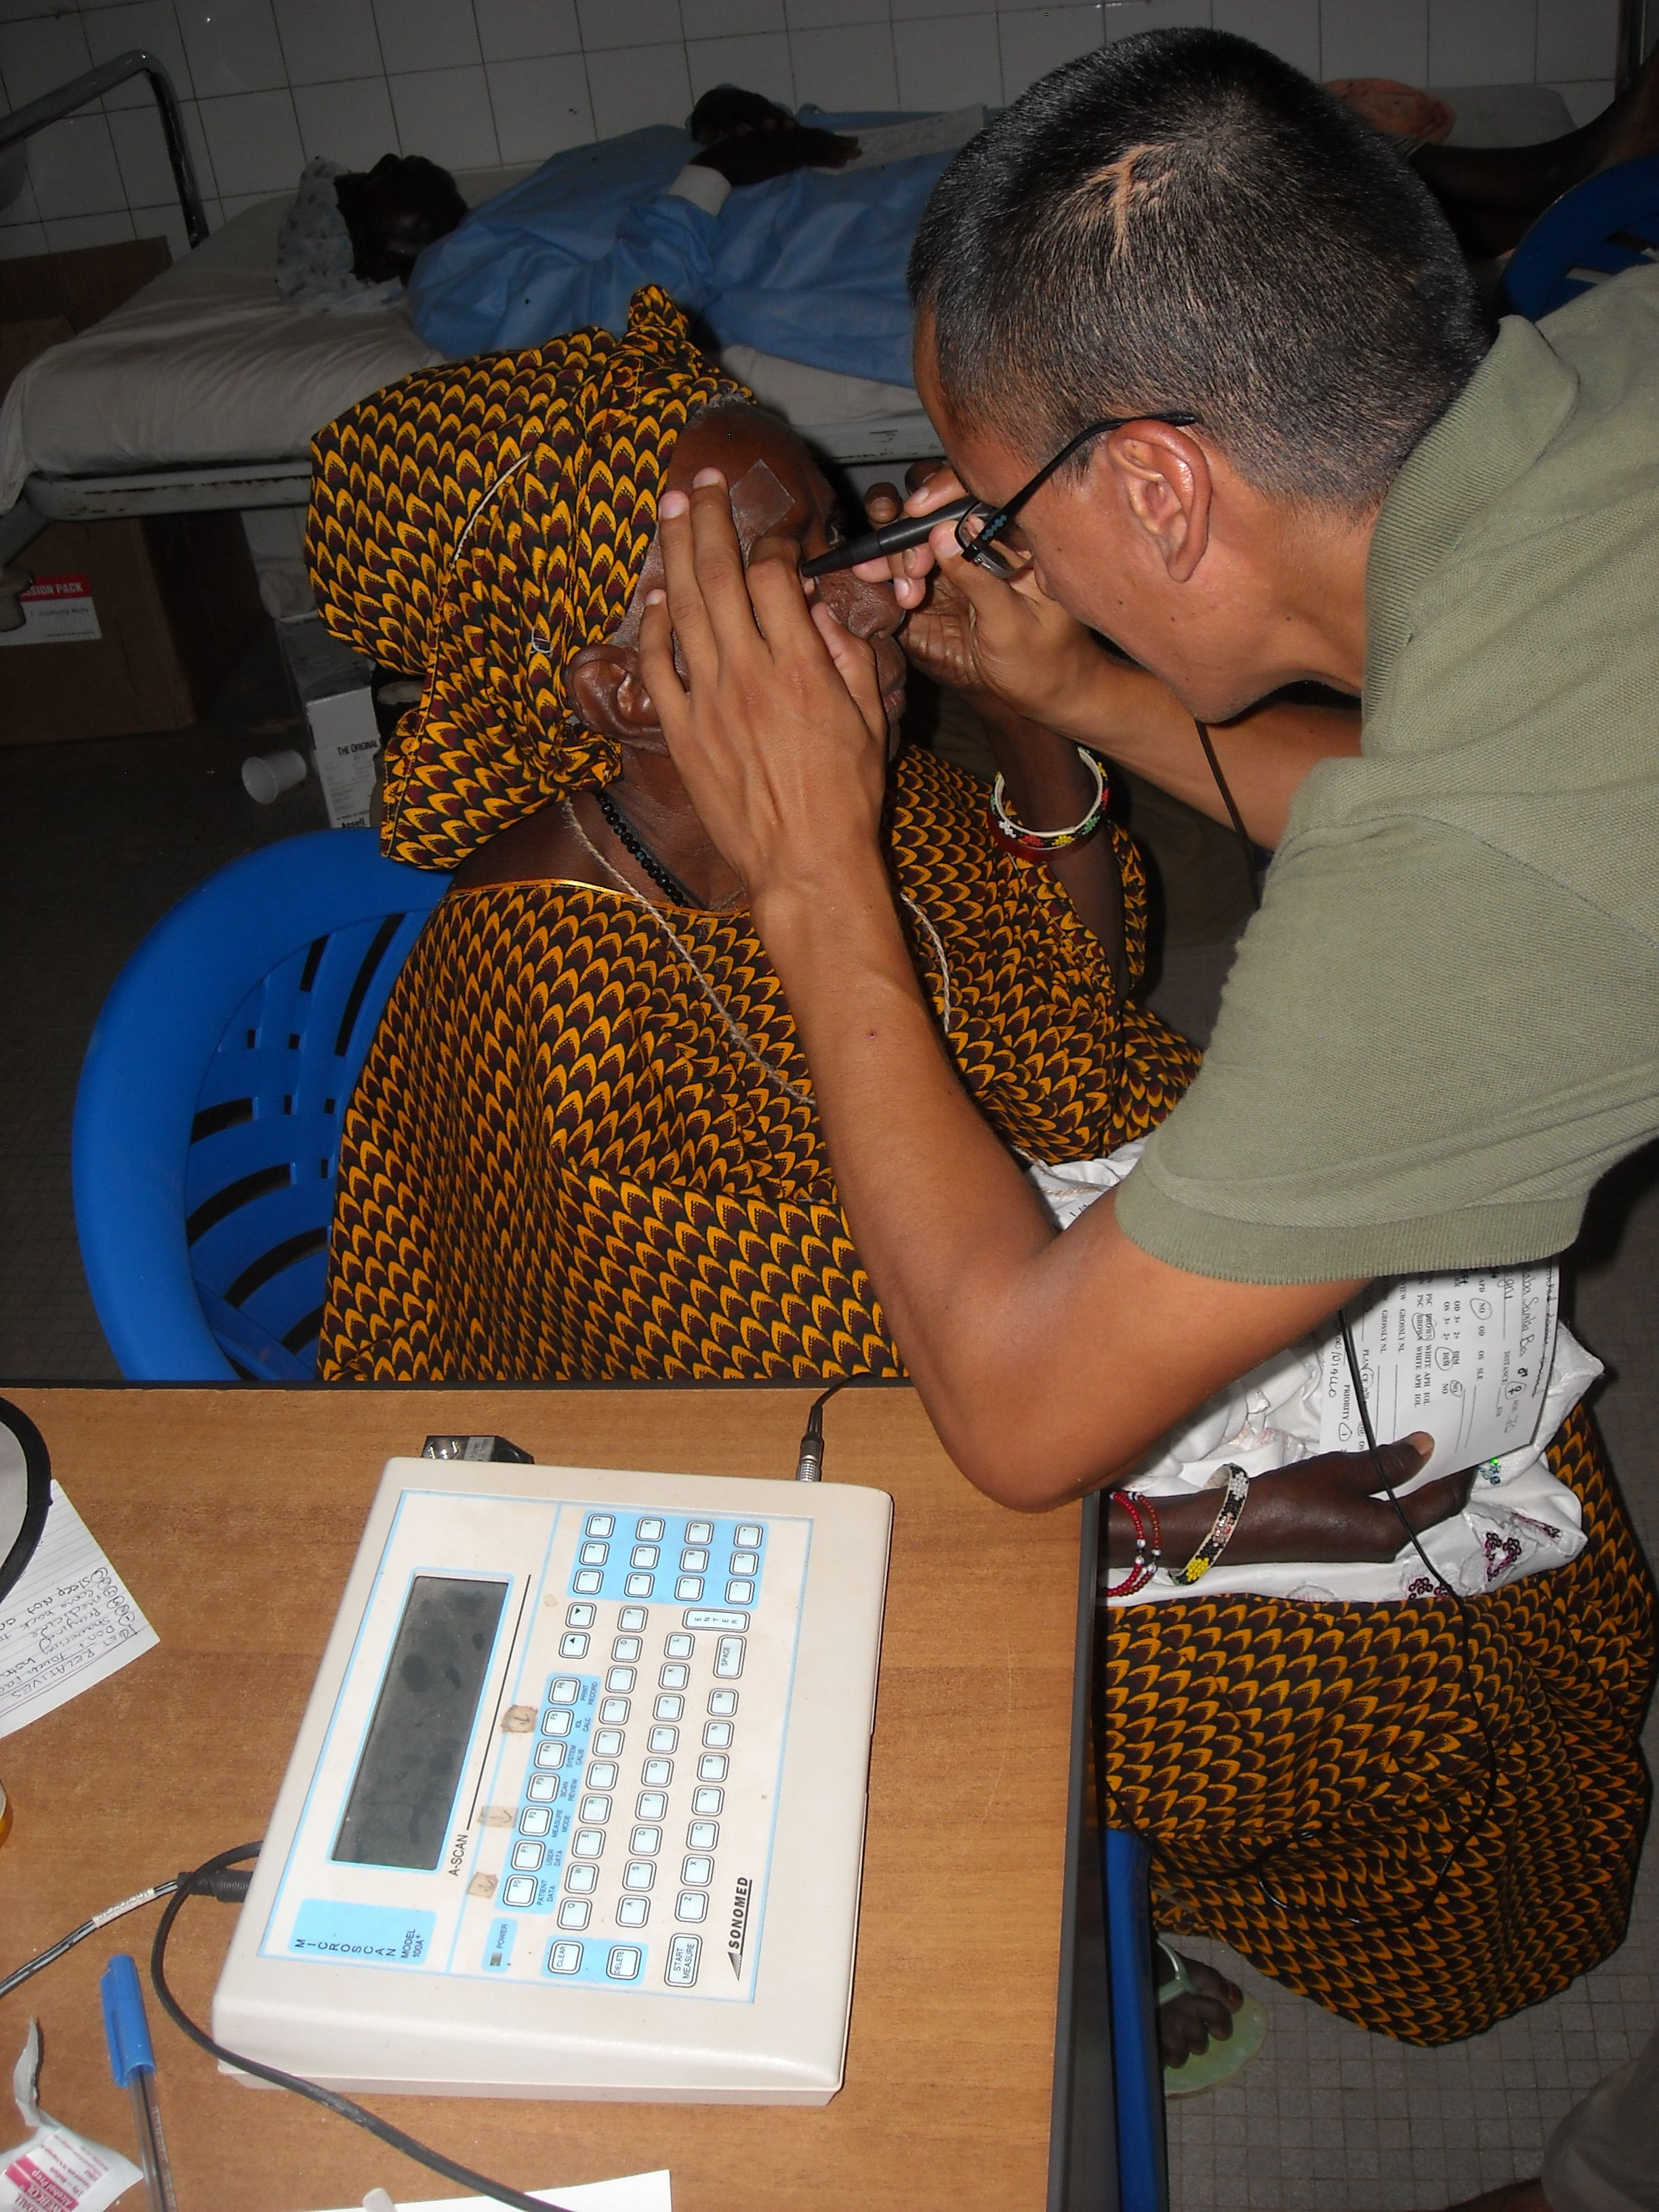
A-scan measurement

Slide 16
SRK-II Formula
IOL Power =
A-constant - 0.9 X K - 2.5 X Axial Length
Myopic eye – longer AL , higher K-s LOWER IOL power
Hyperopic eye – shorter AL, flatter K-s
HIGHER IOL power

Slide 17
A-constant
Always written on box of IOL
Depends on material/shape
For PC lenses: 118.0 - 119.2
If you have different lenses, take average
Better to use the same IOL brand
For AC lenses: 115.0 – 115.3

Slide 18
Error in measurement
IOL Power=A-constant - 0.9 X K - 2.5 X AL
1 mm difference in AL 2.5D
1 D difference in K 1 D
1 difference in A-constant 1 D

Slide 19
Error in measurement
Implanting too high power
MYOPIA
Implanting too low power
HYPEROPIA
Better to err on the side of higher power – better to be myopic!!!

Slide 20
Relationship between IOL power and refraction
1D more power results in 0.7 D more of myopia
2D more ~ 1.5D
3D more ~ 2.0D
4D more ~ 3.0D
5D more ~ 3.5D

Slide 21
Tricks with keratometry
Always check both eyes – usually the same
If different, double-check
If cannot do one eye (eg. Pterygium), use other eye’s measurement

Slide 22
How to do A-scan
Better if always same personnel does it
Touch probe to center of cornea, aim at center of eye
Take at least 5 measurements, 8 better
Machine averages them
If standard deviation is too high (>0.1), retake

Slide 23
Tricks with A-scan
If cannot do one eye, use other eye’s measurement
Always do both eyes (unless PT is pseudophakic) and if IOLs are more than 1D different, repeat
If cannot do one eye, might mean PT has RD, coloboma or other pathology – do B-scan if you have it

Slide 24
Picking the correct IOL
Aim to - 0.5 – -1.0 D refraction – make pt slightly myopic, unless PT drives
Just a personal preference, you can aim for emmetropia too

Slide 25
Correcting A-constant
After about 2-3 months of surgeries, measure your refractive outcome of about 50 patients
If most of them have the desired refraction, you are doing well
If some are nearsighted, some are farsighted, you have to improve the quality of your biometry
If most of them are either near or farsighted, you need to change the A-constant

Slide 26
Measuring refractive outcome
Take spherical equivalent in a month:
Eg: -0.50 - 3.00x90 deg = [-2.75]
Eg: +1.00 - 2.00X80 deg= [0.00]
Eg: +3.00 – 3.00x110 deg=[+1.50]
Spherical equivalent stays constant after astigmatism wears off

Slide 27
Correcting A-constant
If your patients come out too nearsighted, means you are implanting too high IOL
Decrease A-constant – IOL number will be lower
Ie. You are aiming for -0.5D but PTs are -1.5D, change A-constant from 119.5 to 118.5

Slide 28
Correcting A-constant
If your patients come out too farsighted, means you are implanting too low IOL
Increase A-constant – IOL number will be higher
Ie. You are aiming for -0.5D but PTs are +0.5D, change A-constant from 118.5 to 119.5

Slide 29
Monovision after bilateral cataract surgery
Goal is for PT to see distance and also near without glasses
Can be achieved only if biometry is available
Improves the PT’s quality of life with minimal extra effort – prescription glasses are available only for the affluent part of society

Slide 30
Eye dominance
Determine by holding up circle from fingers in front of small distance target with both eyes open
Can also ask PT to shoot or take picture with camera– eye kept open is dominant eye

Slide 31
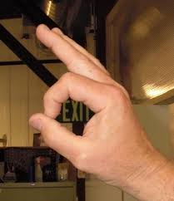
Eye dominance

Slide 32
Eye dominance
80% of people are RIGHT eye dominant
Dominant eye should be corrected to distance
Non-dominant eye should be corrected to near
In a population with lower visual needs, the right eye can automatically be corrected to distance and left to near
Usually no problem cinically if wrong eye is picked

Slide 33
Calculations
Add 2 diopters to the IOL power of non-dominant eye (usually OS) – this will mean -1.5D myopia
The brain can tolerate <3.0 D of anisometropia
It is always better to err on the side of myopia meaning higher IOL power – it is better to be myopic than hyperopic (At least one can see near) – so if in doubt, always implant the HIGHER IOL power.

Slide 34
Examples:
Biometry is IOL 21 OU – implant 21 OD and 23 OS
Biometry is IOL 19 OD and 21 OS – double-check, the two eyes should be within 1D
If same the second time – implant IOL 19 OD and 23 OS
If biometry is 23D OD and 24D OS, implant 23D OD and 26D OS

Slide 35
Correcting IOL power for monovision after one eye had cataract surgery
Perform autorefraction or refration on the operated eye
If eye came out nearsighted, make other eye emmetropic
If eye came out farsighted, make other eye -2.00D less (to avoid anisometropia)
If eye is emmetropic, make other eye nearsighted

Slide 36
Examples
Biometry is 21.0 D OU, but OD is [-1.50D] postop – make OS 19.0 D
Biometry is 19.0 D OU but OD is [+ 1.0D],
make OS 21 D
Biometry is 24.0 D OU, and OD is [0.0D], this is as you planned – make OS 26.00-success!!!

Slide 37
Checking outcomes of monovision
Check uncorrected binocular distance and near vision 3 months postop

Slide 38
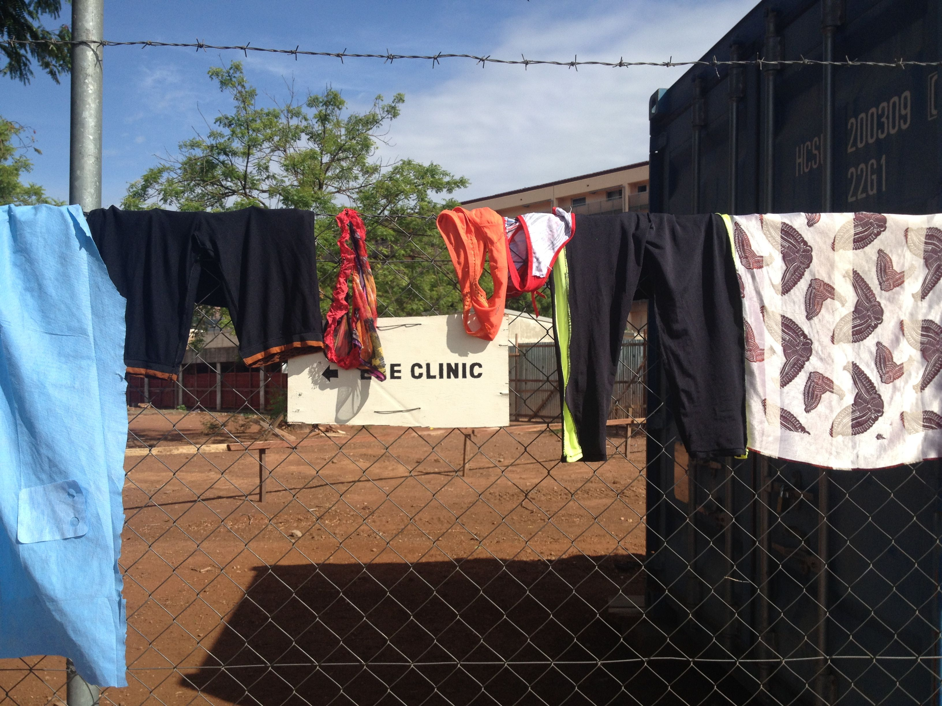
Thank you for your attention !

