Slide 1
Chronic Angle Closure Glaucoma
Judith Simon MD
Dept. of Surgery, TTH

Slide 2
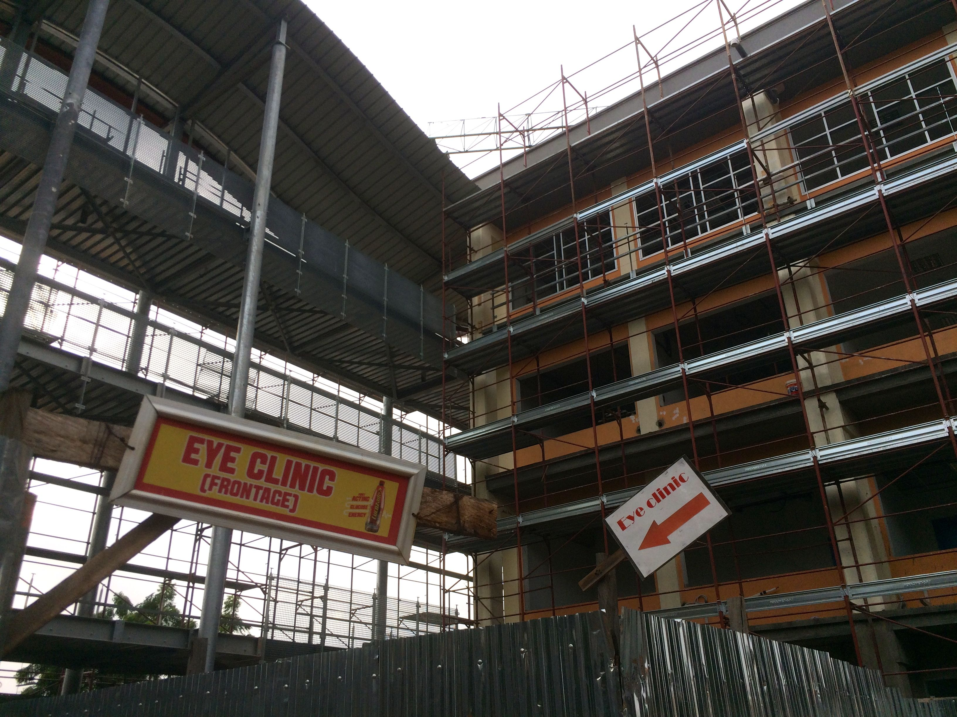
TTH Eye Clinic

Slide 3
Primary Angle Closure Glaucoma
AACG – Acute Angle Closure Glaucoma
CACG – Chronic Angle Closure Glaucoma
CACG is much more common
CACG can progress to AACG if not treated

Slide 4
Pathophysiology
Symptoms
Diagnosis
Treatment – recent paradigm shift
Case study

Slide 5
POAG vs PACG
PACG is about 25% of all glaucomas
Estimated 5.9 mil vs 5.3 mil blind by 2020
How is this possible???

Slide 6
POAG vs PACG
Risk of blindness is 3x greater in PACG!
Prevalence of PACG is 2-4x more common in West than previously reported
Reason????

Slide 7
Pathophysiology of PACG
Pupillary block mechanism
Non-pupillary block mechanism
  Plateau iris
  Thick iris
  Thick lens
  Ciliary block

Slide 8
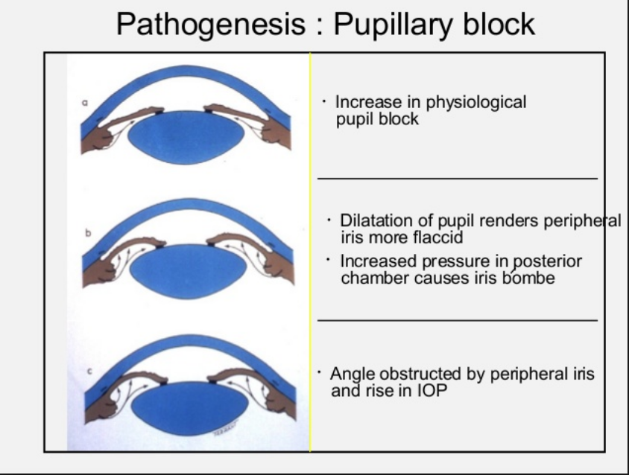

Slide 9
Non-pupillary block
As lots of PTs (60-80%) still have IOP rise after dilation even after LPI, there must be other mechanisms responsible too

Slide 10
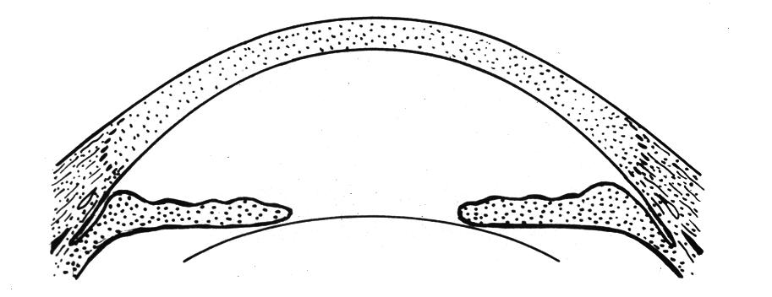
  Plateau iris

Slide 11
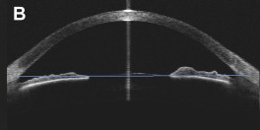
Normal angle

Slide 12
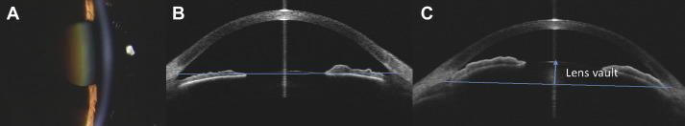
Narrow angle with thick lens pushing iris forward

Slide 13
Symptoms of CACG
Usually none until severe damage
PT can have halos around light/headache/blurry vision episodically

Slide 14
Diagnosis
First we MUST think about it so we could notice it!!!
Shallow AC – suspect PACG
Deep AC and high IOP – suspect PACG

Slide 15
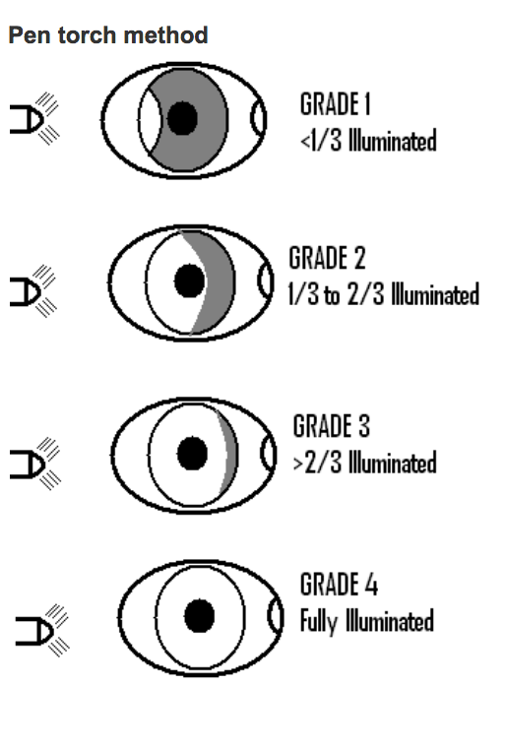
ACD Grading by Pentorch

Slide 16
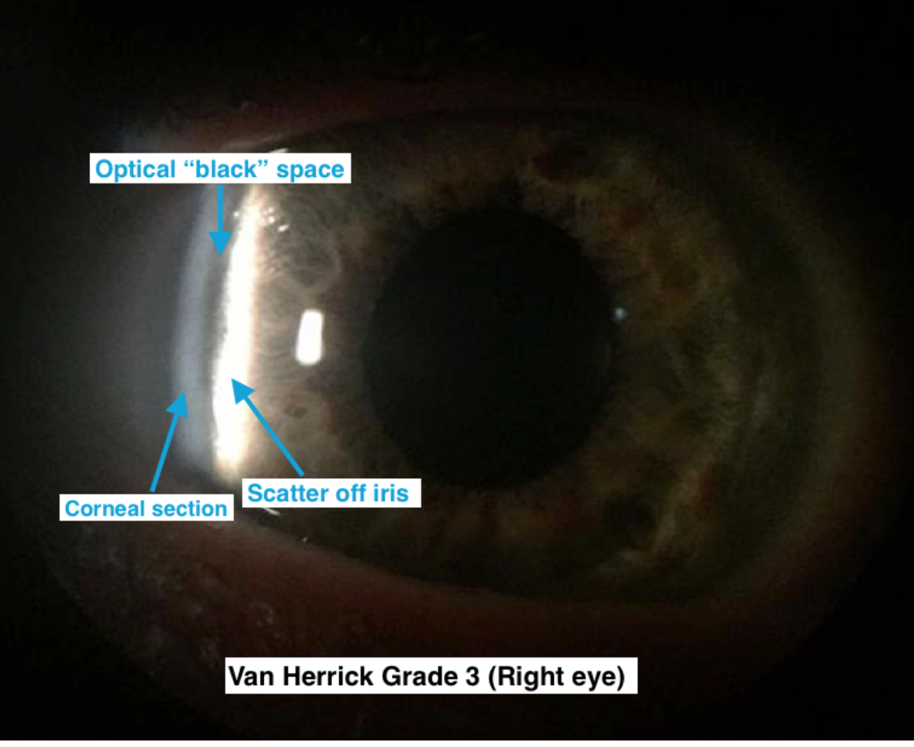
AC Grading by Van Herrick method

Slide 17
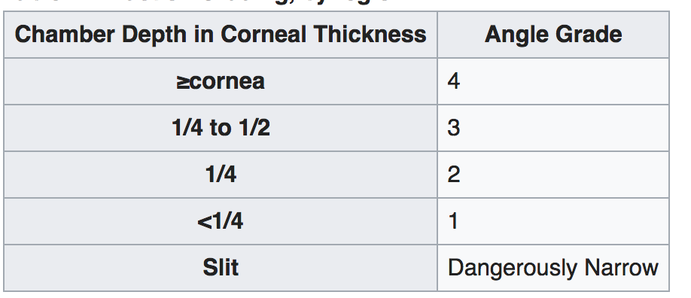
AC Grading by Van Herrick method

Slide 18
Suspicion of CACG
Very high IOP (>40) in the absence of secondary causes
IOPs fluctuate greatly from one visit to next on treatment
Disc damage with NL IOPs (might be misdiagnosed as NTG)
IOP significantly greater after dilation
Minimal or no response to glau drops

Slide 19
Gonioscopy
The gold standard of evaluating the angle
MUST learn, practice and TEACH!!!
Motivated eye nurses can also learn
Every glaucoma patient should have it yearly !!!

Slide 20
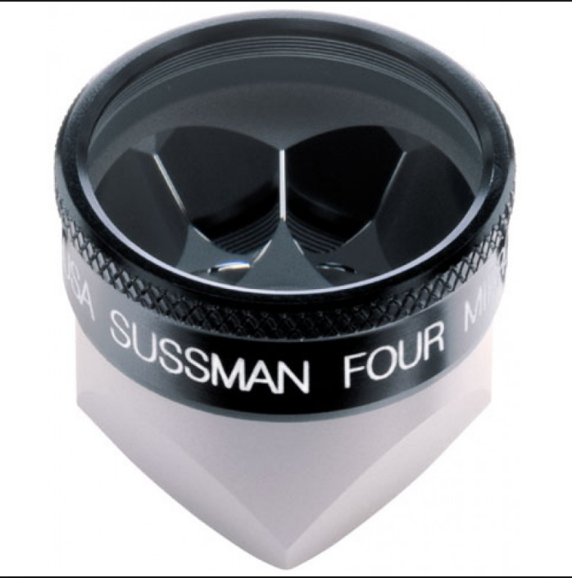
Sussmann lens – no goniosol, can do indentation gonioscopy

Slide 21
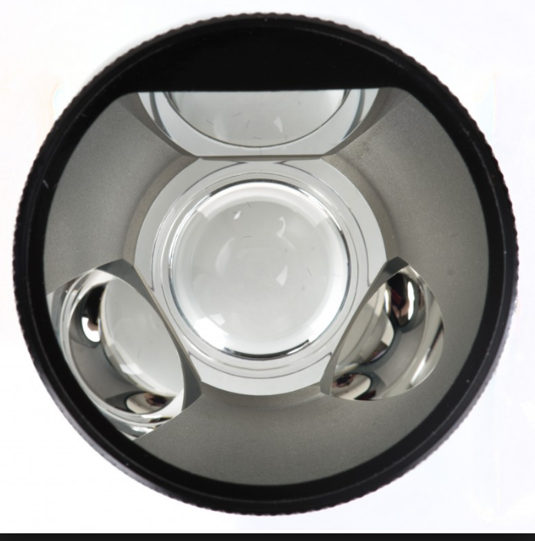
3-mirror lens – better view, requires goniosol

Slide 22
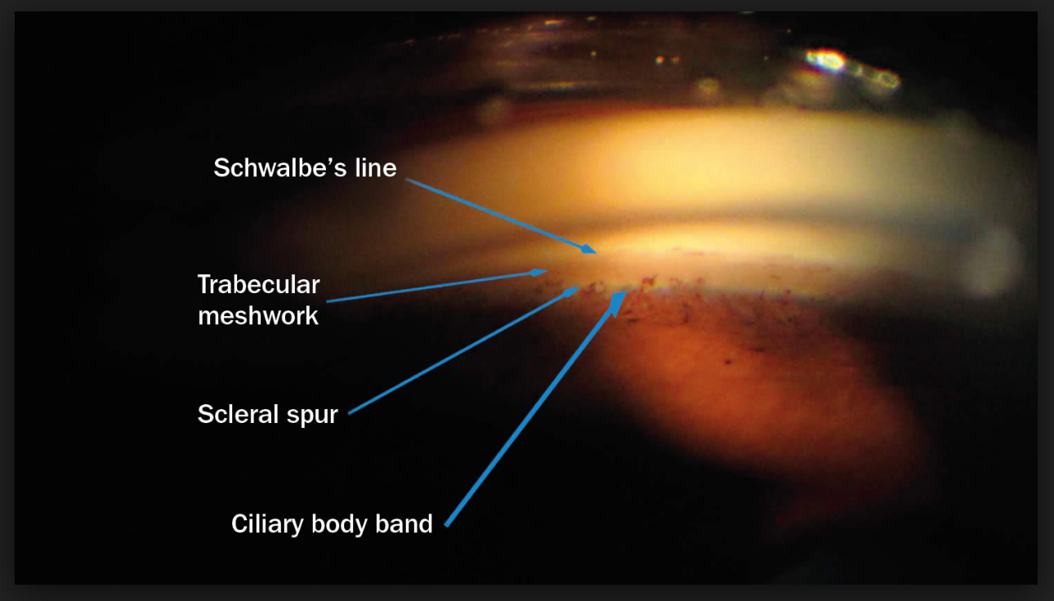
Normal open angle

Slide 23
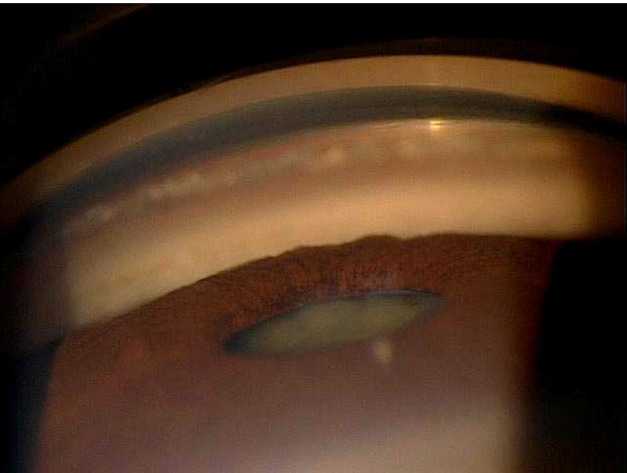
Narrow or closed angle

Slide 24
More on gonioscopy
The only way to learn it is to DO IT!!!
Must see a lot of normal angles to be able to tell pathology
Always check both eyes
Quite difficult to learn, do not get discouraged!

Slide 25
Treatment
Pilocarpine drops
Laser iridectomy
Surgical iridectomy
Cataract extraction
Clear lens extraction

Slide 26
Laser iridectomy
Prophylactic – Prevents ONLY AACG
  In PTs who have narrow angles but asymptomatic
  In PTs with other eye AACG
  In PTs with CACG
Therapeutic
  For AACG
  NOT In CACG, IOP decreases in only 40% or less of patients

Slide 27
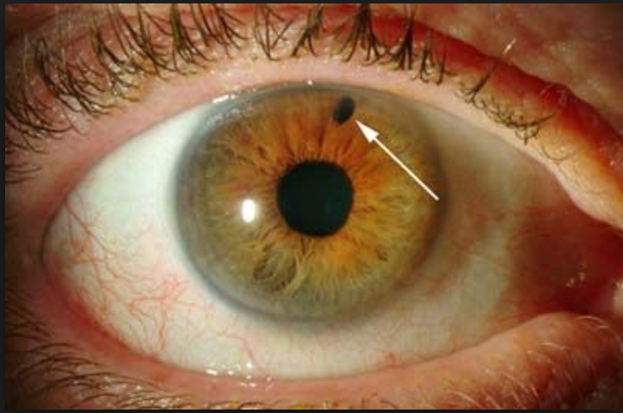
Laser iridectomy

Slide 28
YAG LASER IRIDECTOMY INFORMATION
You have a condition called angle closure glaucoma in both of your eyes. This causes very high eye pressures. The high eye pressure can kill your optic nerve, the wire connecting your eye to your brain, and your vision might be lost forever. You need a laser treatment to PREVENT your eyes from going blind. You will NOT be able to see better after the laser. Your vision will become blurry for a few days and then return to what it was. If you already lost vision from glaucoma, it will not return, the laser just prevents your eyes from getting worse. We will do the laser only on one eye, and in one or two weeks we will do it on the other eye.
The procedure lasts only for a few minutes and you might have small pain. It costs 20 GhC. Your will need to use eyedrops for 2 weeks and need to come for follow-up. Please let us know if you have any questions.

Slide 29
EAGLE Study
Effectiveness of Angle closure Glaucoma treatment with Lens Extraction
419 Pts, >age 50, IOP>30, no cataract
Half clear lens extraction, other half LPI + medical therapy
3 year follow-up

Slide 30
Results
 | Clear Lens Extr | LI + drops
Drops needed | 0.4 | 1.3
IOP | 1.2 mmHg lower
Vision | 3 ETDRS letter better
Additional surgery | < 0.5% | 9%
Cost | Cheaper
QOL | Better

Slide 31
Lens extraction in Ghana
If PT has a cataract, do it! (>6/24)
If access to phaco, can do it with clear lens
In advanced cases beware of snuffout – no retrobulbar/pressure on globe, give Diamox postop

Slide 32
Case study
65 yo F
VR 6/24, VL HM
IOPs 35/46
CDR 0.9/1.0
VF advanced gl defect OD
SICS done OD
VR 6/12 2m later, IOP 15 without drops

Slide 33
Conclusion
Always think of chronic angle closure when seeing glaucoma patients!
Do gonioscopy!
Remove lens as primary treatment, or if vision is very good, do Laser Iridectomy!

