Slide 1

UPDATE OF
CATARACT IN GHANA
AIDS TO A HIGH CATARACT SURGICAL RATE
Dr. Boateng Wiafe
Notes:
<number>

Slide 2
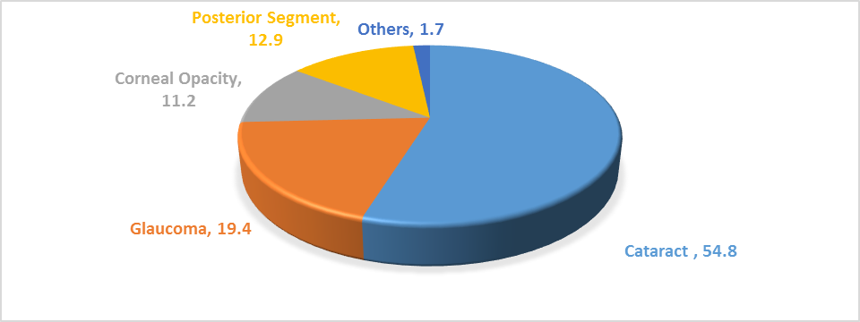
Principal Causes of Blindness

Slide 3
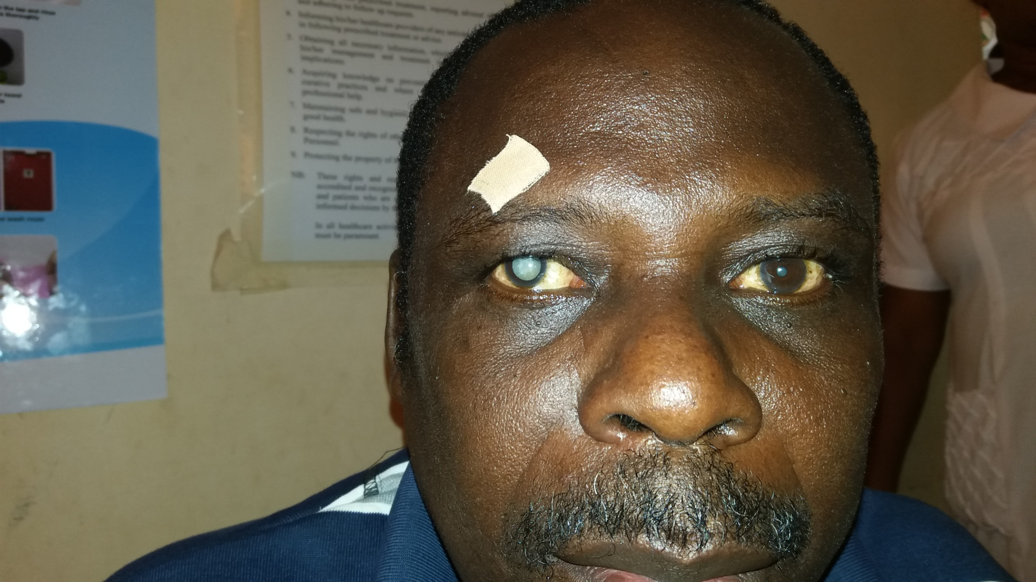
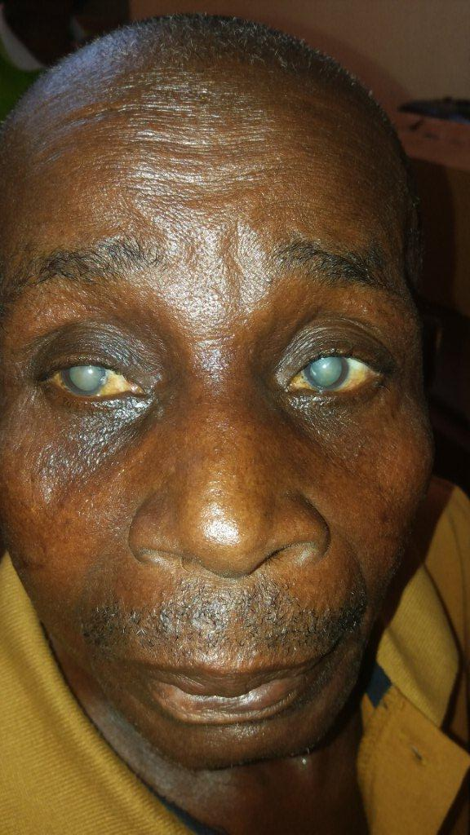
They are still with us

Slide 4
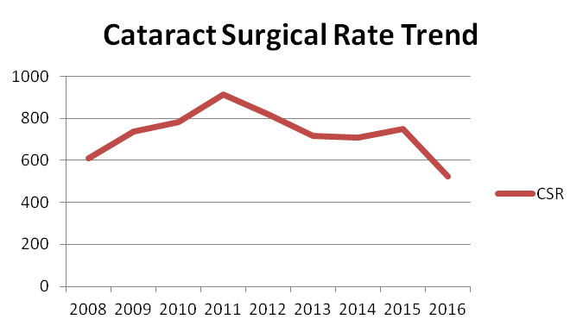
INTRODUCTION
You will all agree with me to the fact that the
CSR in Ghana is declining despite the fact that we have more ophthalmologists and more support available than it used to be

Slide 5
Why has the CSR remained low?
Cataract Surgical Rate in Ghana has remained low and it is declining. Why is this the case?
2 Reasons :
There is no demand for Services – Patients are simply not coming for surgery
There is a long waiting list but the eye unit is not functioning effectively or efficiently

Slide 6
Why are people not coming for surgery?
Lack of Awareness – patients do not know that cataract blindness is treatable or even that treatment is available near them
Beliefs – reports indicate that elderly people are often resigned to sight loss, believing it to be just part of the aging process, or that there is no need for good sight when you are old

Slide 7
Why are people not coming for surgery?
Cost – Cost is a repeated barrier as patients experience both direct and indirect costs if they wish to get surgery and sometimes other family priorities are regarded as more important
Distance – Distance from the hospital or lack of transportation remains a challenge for many

Slide 8
Why are people not coming for surgery?
Traditional Healers/ prayer camps – Easier access to alternative care is a challenge in many settings.
Fear – Overall lack of knowledge about cataract and its treatment results in fear of surgery
There may be many other barriers specific to different areas in the country and it is important to attempt to understand these so appropriate services and health education activities can be developed to help overcome them

Slide 9
Managing Lack of Demand
Barrier | Option for Managing
Lack of Awareness | Promoting your services
Beliefs | Providing Health Education in a culturally sensitive manner
Cost | Identifying ways to minimize the payment burden on patients or reduce costs in the clinic

Slide 10
Managing Lack of Demand
Barrier | Options for managing
Distance | Consider outreach or transport for patients
Easy Access to Traditional Healer / Prayer Camps | Improving Hospital Access
Fear | Counseling for patients and family

Slide 11
Provider related Barriers
Barriers
Manpower
Materials
Management
Motivation
Money
Provider related barriers are often due to poor planning and management in five key areas

Slide 12
Manpower (Human Resources)
Are there enough personnel?
How efficient is the theatre?
An efficient theatre should be able to perform at least 4 cataract surgeries per hour

Slide 13
Capacity of the Service
To calculate the maximum volume of surgery that can be performed,
  We multiply efficiency by the number of surgery days available and by the number of surgeons
Maximum number of surgery =
EFFICIENCY
x
SURGERY DAYS
AVAILABLE
x
NUMBER OF SURGEONS

Slide 14
Materials
Number of Operations per theatre per year
Availability of good equipment and instruments
Regular supply of consumables
Surgical Output is dependent on how we use Materials. For example, the number of surgeries per theatre per year, the availability of regular and good instruments, functional equipment and a regular supply of consumables.
Challenges in this area need to be identified and solutions found

Slide 15
Management
Management is key for an efficient flow of work in any eye unit
Identify and address bottlenecks and gaps in patient flow and operating theatre layout

Slide 16
Motivation
Motivation is closely linked with the conditions that people work in and how the team functions
Opportunities and career maps also play a role in ensuring retention of staff

Slide 17
Money
Money often poses the most challenges
Sustainability is the balance between income generation and expenditure

Slide 18
Meeting the Demand
We need a multi-pronged approach to improve service delivery and meet the demand:
  The recruitment and training of staff
  The supply , use and maintenance of instruments and equipment
  Appropriate funding options for patients. E.g tier payments or insurance schemes
  Patient flow rates, surgeries per hour
  More theatre days
  Task sharing , task shifting, team approach to eye care

Slide 19
Meeting the Demand
It is important to understand the reasons why the CSR is low before you proceed to address them
Sometimes both kinds of barriers need to be addressed:
  To create patient demand and
  Balance it with good service delivery

Slide 20
equity
Equity is central to cataract service delivery
Equity can be defined as ensuring fair distribution of services without discrimination against age, gender, ethnicity and so on

Slide 21
Models of equity in eye care
Model | Comment
Wait for the patient in the clinic | Not always effective either for increasing output or ensuring equity
Screen in the community and refer | This can be a target activity but it has to be done regularly to be effective
Screen and operate in the community | Again these outreach activities have to be sustained
Screen in the community and transport to unit | This model is the most effective where transport is a huge problem especially for the poor
Community based health workers and referral | This is an effective model as the community worker is known to the community and local people have confidence in them
Satellite hospital in a rural setting | This model is usually expensive to set up but does provide comprehensive care

Slide 22
In conclusion
To increase demand for surgeries patient barriers have to be understood and addressed
To increase supply of services, eye units need to assess their own efficiency and effectiveness
Management of both these activities above is central for a coordinated and sustained impact on the CSR

Slide 23
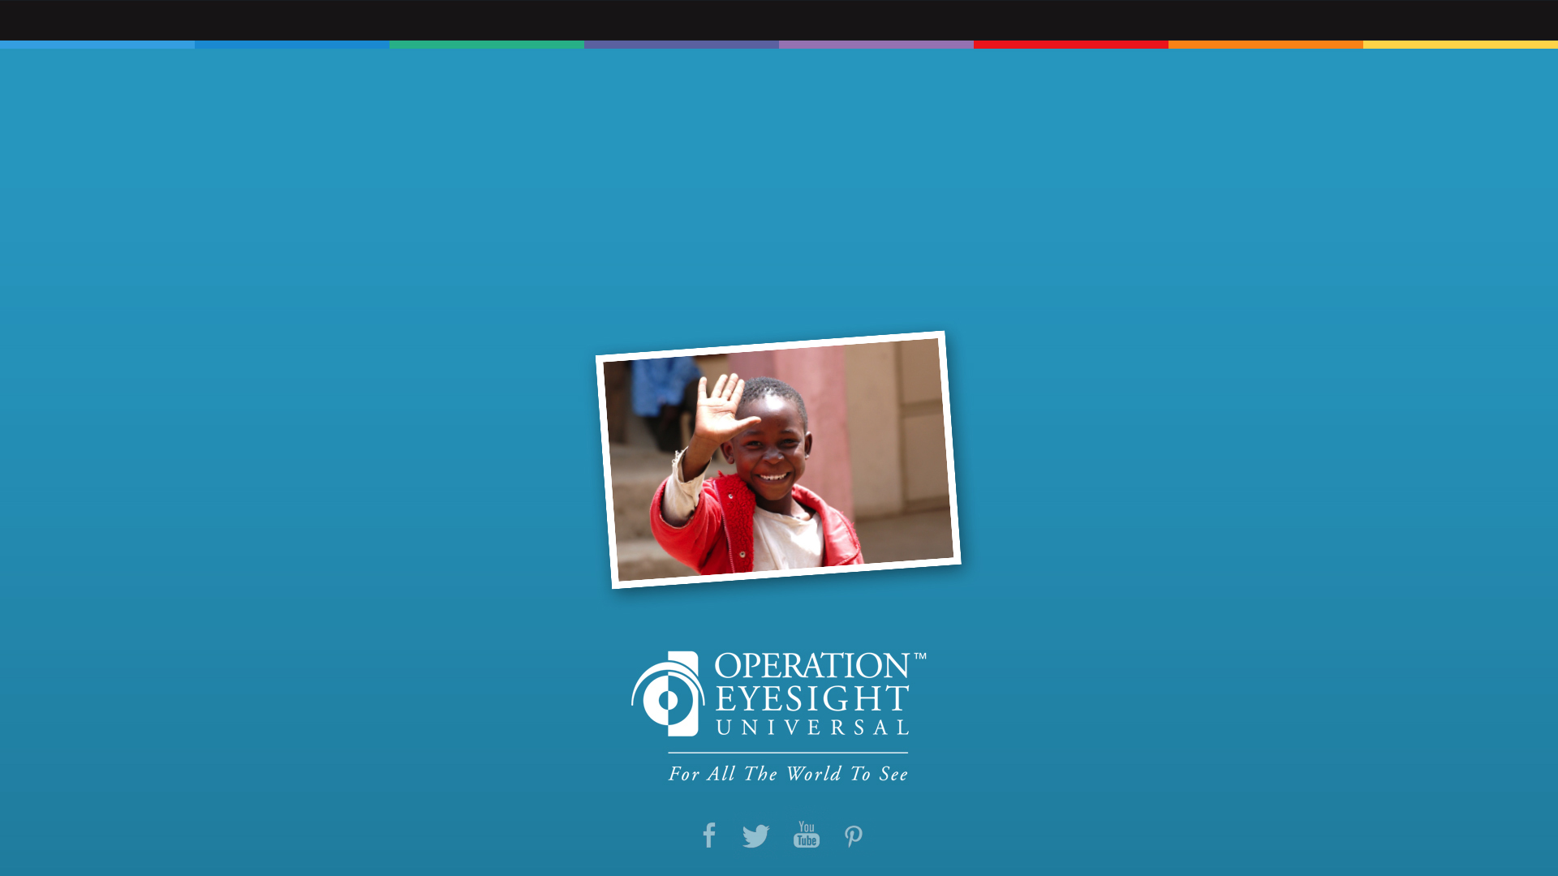
Thank you
operationeyesight.com
Notes:
<number>

