Slide 1
The Prevention and Treatment of Postoperative Endophthalmitis
Judith Simon MD
Tamale Teaching Hospital,
Dept of Surgery/
Ophthalmology

Slide 2
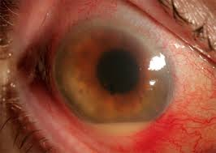
Endophthalmitis

Slide 3
Prevention of Postoperative Endophthalmitis
It is the most feared and devastating complication of intraocular surgery
Difficult to study as it is rare
Until 2006 the only treatment proven in studies to prevent it is 5% iodine drop before surgery
Pre or postoperative antibiotic drops, subconjunctival antibiotics and antibiotics added to the irrigating fluid were NEVER proven to be of benefit

Slide 4
Intracameral Cefuroxime
From 2003 to 2006 a study was done in Europe including 14 000 patients which showed a decrease of postoperative endophthalmitis rate with 80%. It has a huge benefit!
It is extremely cost effective and easy to administer
Every eye surgeon should be using it. There is NO excuse not to introduce it!

Slide 5
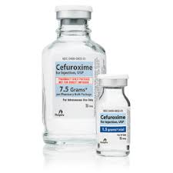
Cefuroxime bottle

Slide 6
Dosage and administration
The bottle is 750mg powder, for IV use
Only 3 GhC and covered by NHIS and available
1mg has to be injected in 0.1 cc
The solution is stable in the fridge for a week
One bottle is enough for several hundreds of patients

Slide 7
Dilution
To 750 mg bottle add 7.5 cc of NS
Solution is 100 mg/cc
Put 1 cc of solution in syringe, add 9cc of NS. Do not use sterile water.
Diluted solution is now 10mg/cc
Transfer about 0.4 cc of solution to a 1cc syringe or TB syringe
Push out plunger to 0.1 cc before injecting

Slide 8
Administration
The Cefuroxim solution has to be injected to the AC at the completition of surgery
Can use AC canula on 1cc syringe or needle on TB syringe
If there is sideport, use that. Be careful not to collapse AC.
Do not rinse eye after Cefuroxim, or if have to, readminister

Slide 9
Results
You will experience a dramatic reduction of endophthalmitis rate!!!
(Though you probably never had it, right?)
Also obviates use of subconjuctival gentamycin

Slide 10
Treatment of postoperative endophthalmitis
As you may have experienced, antibiotic drops, subconjunctival and po antibiotics are of MINIMAL help as they do not penetrate the vitreous
The only effective treatment is INTRAVITREAL ANTIBIOTICS
It has to be given urgently, even a few hours of delay can blind the patient

Slide 11
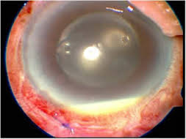
Postoperative endophthalmitis

Slide 12
Antibiotics to give and dosages
Most effective for G+:
Vancomycin 1mg/0.1cc
Can also use:
Cefuroxim 1mg/0.1cc – available In Ghana
Most effective for G-:
Ceftazidime 2.0 mg in 0.1 ml
Amikacin 0.4 mg in 0.1 ml
Can also use:
Gentamycin 0.1mg/1cc– available In Ghana

Slide 13
Dilution of antibiotic
Always use preservative free preparation – IV powder is always good
Figure it out (simple math) or look it up on the internet
Use NS for dilution, not sterile water
PRINT INSTRUCTIONS AND TAPE TO WALL OF CLINIC OR THEATER
http://www.cehjournal.org/resources/eye-surgery-in-hot-climates/

Slide 14
Technique of intravitreal injection
Put Alcain and 5% Iodine drops into eye
Put sterile speculum
Best is inferonasal or inferotemp. quadrant
Measure 4mm from limbus with sterile caliper – go through the pars plana
Aim towards the center of eye
Inject antibiotic with TB syringe – push plunger up to 0.1 cc, no air

Slide 15
Technique of intravitreal injection
If second injection is given, wait at least 30 m and give IOP reducing drop and Acetazolamide
Several 100 000s of intravitreal injections are done yearly in developed countries for macular degeneration (mainly Avastin) with minimal complication rates

Slide 16
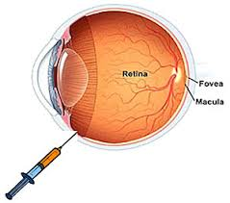
Technique of intravitreal injection

Slide 17
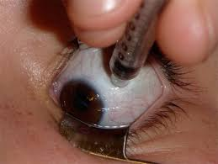
Technique of intravitreal injection

Slide 18
Who performs the injection?
Teach ALL of your residents and ophthalmic nurses to do it!
If you do not have them, teach regular nurses – those who are on duty
Always keep a bottle of Cefuroxim and a vial on Gentamycin for emergencies
Make sure the staff knows where the antibiotics are

Slide 19
Additional treatment
Can take aqueous and vitreous for culture
If no response, intravitreal abx can be repeated in 2 days, or can try different abx depending on the culture results
Add abx drops, hourly steroid drops, cycloplegics, retroseptal Triamcinolone and po abx.
Intravitreal steroids – give it if you have, has to be preservative free:
Ie: Dexamethasone 400 micrograms in 0.1 cc

Slide 20
Summary
No reason to “be afraid” of giving the intravitreal injection – there is nothing to loose!
The patient will go blind nearly for sure if it is not given.
If it is done in time and correctly, it can save the eye.
Can be used also for traumatic or endogenous endophthalmitis

Slide 21
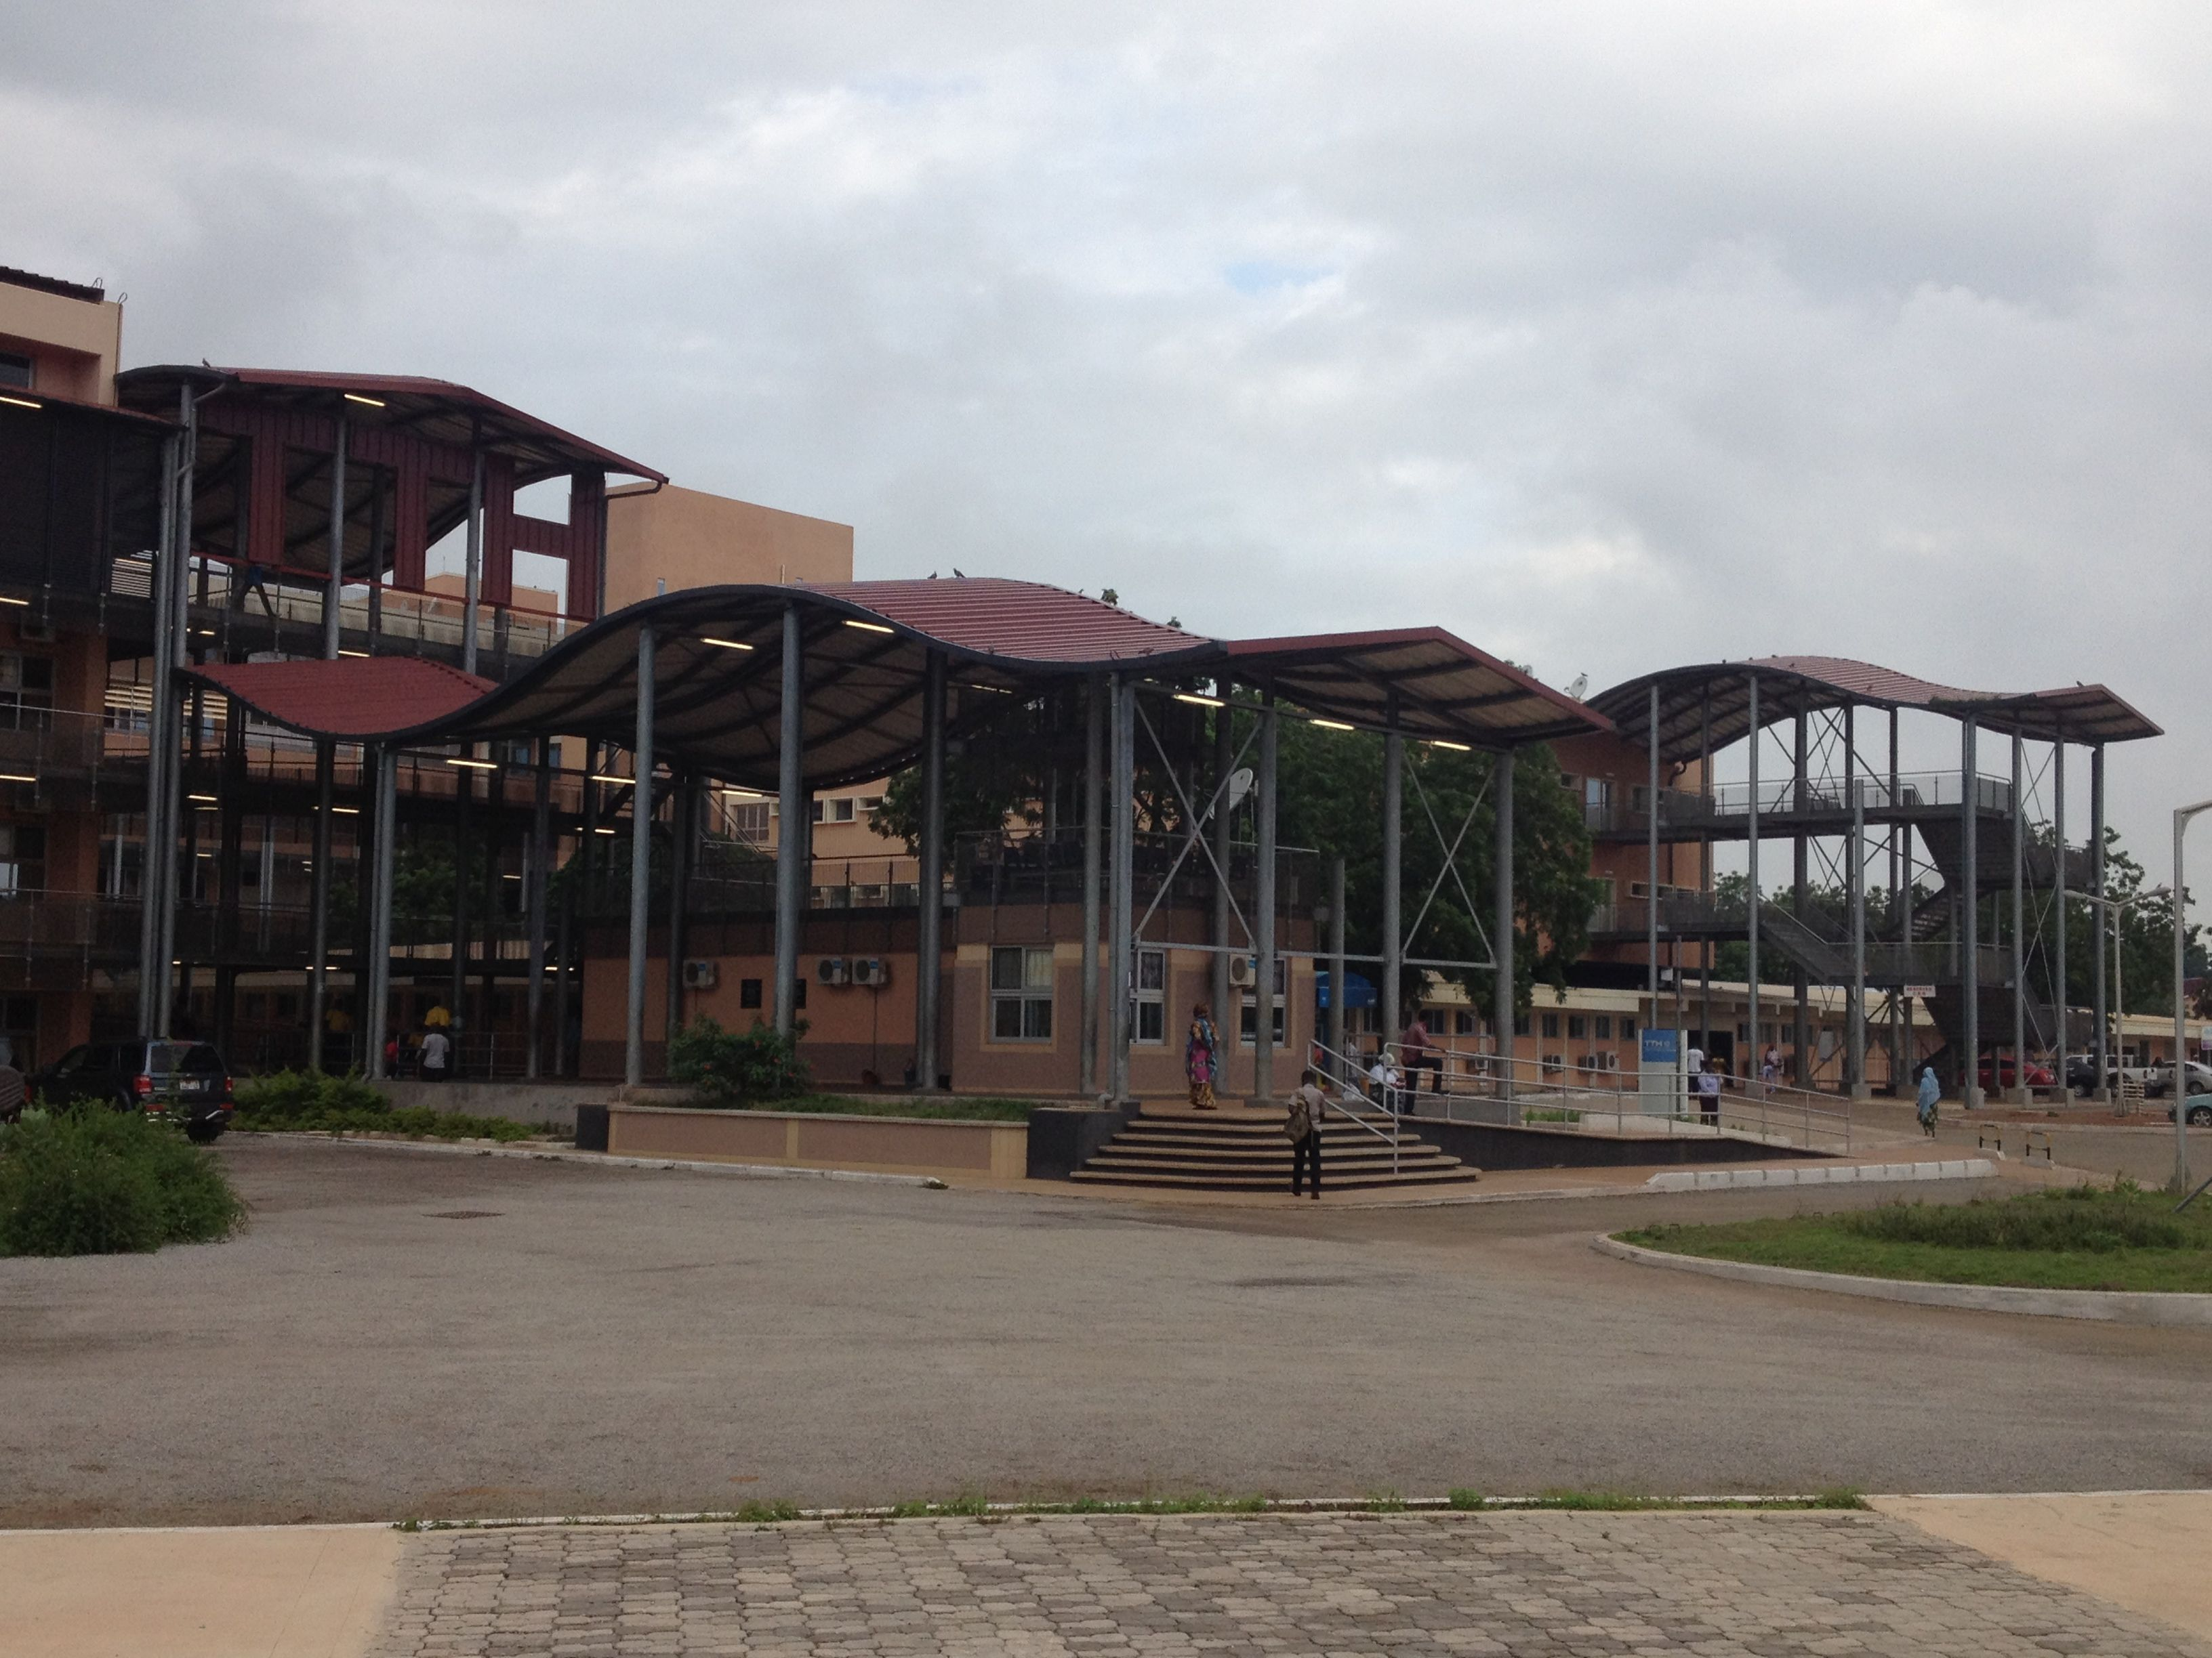
Thank you for your attention!

