Slide 1
Iris Claw IOL -
When There Is No Posterior Capsule
Judith Simon MD
Ophthalmologist
Tamale Teaching Hospital

Slide 2
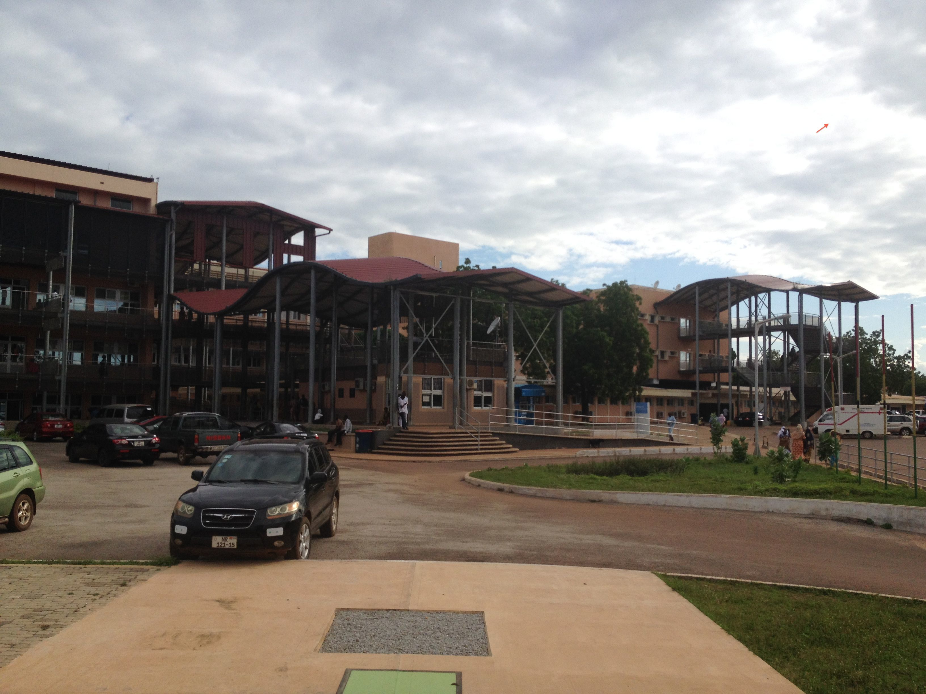
Tamale Teaching Hospital

Slide 3
Objectives
Description of IOL
Indications for implantation
Contraindications
Surgical technique
Advantages over AC and scleral-fixated IOLs
Complications
Studies

Slide 4
When there is no PC*:
Leave PT aphakic
AC IOL
Sutured-in PC IOL
Iris Claw IOL

Slide 5
History
Iris-fixated IOLs appeared in the late 60s
Dr Jan Worst – Invented the iris claw IOL in 1970
Today it is used as a phakic IOL in developed countries (Artisan, Verysite)

Slide 6
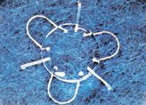
Sputnik IOL

Slide 7
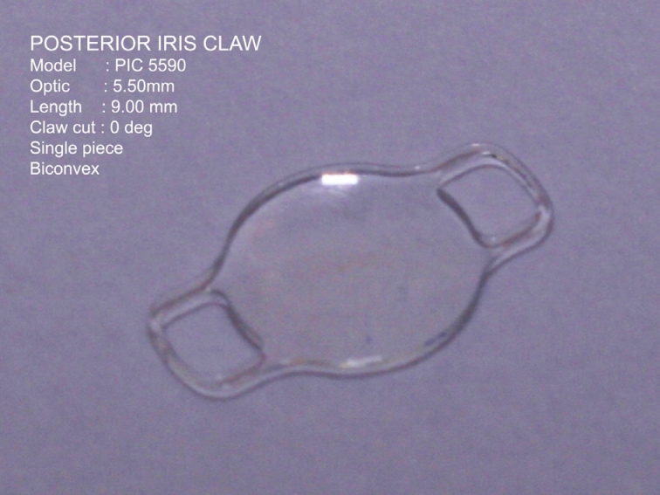
Iris Claw IOL

Slide 8
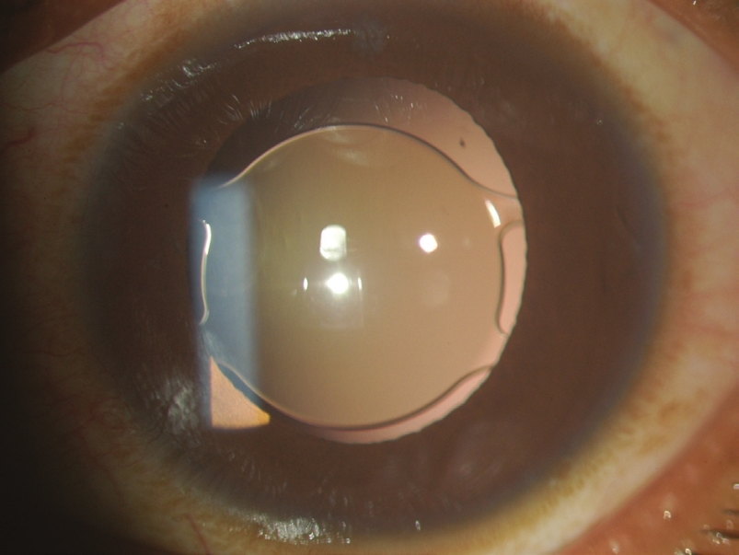
Iris Claw IOL behind iris

Slide 9
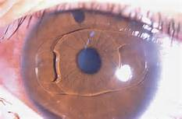
Iris Claw IOL in front of iris

Slide 10
Indications
Preoperative zonular dehiscence of any etiology:
  Trauma
  Marfan syndrome/ectopia lentis
During surgery:
  Large zonular dehiscence
  Large PC rent
  Whole bag removal
  ICCE

Slide 11
Indications
Postoperative PC IOL dislocation
  Dropped IOL
  Pseudoexfoliation
  Trauma
In aphakia as secondary IOL
  After couching
  Dropped lens 2 to trauma
  Surgical aphakia

Slide 12
Indications – Where AC IOL is contraindicatied
Glaucoma
Pediatric/young patients *
Corneal endothelium unhealthy

Slide 13
Contraindications
Uveitis
Large iridectomy/sphincterotomy
Iris atrophy
Pseudoexfoliation

Slide 14
A-constant:
Retropupillary: 117.0
Prepupillary: 115.0
Can order power of 20 D if do not want to order a range of powers

Slide 15
Price
20$ from Appasamy
Might be cheaper from other distributors
Can factor in price to PC IOL

Slide 16
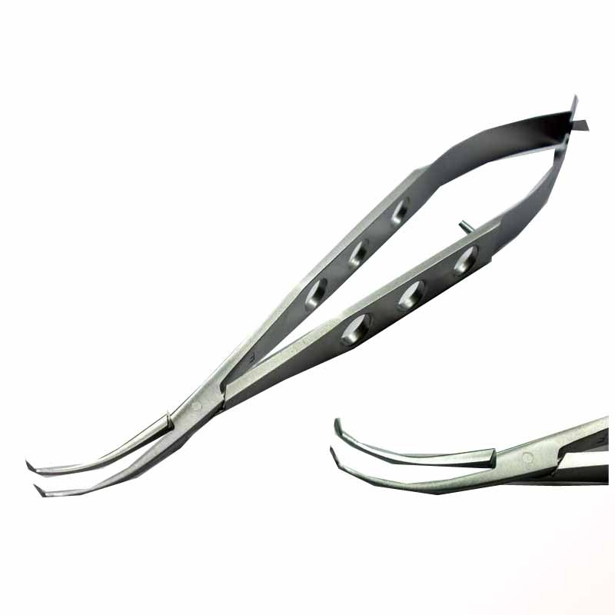
Special instruments needed: Only lens holding forceps

Slide 17


Slide 18
Advantages vs AC IOL
Can be implanted in OHT/glaucoma
Less pseudophakic bullous keratopathy
Less/no chronic uveitis
Better results especially in settings without vitrector*

Slide 19
Advantages vs scleral fixation
Much faster surgery
Much cheaper
Much easier
No special instruments/sutures/glues needed
No suturing needed or just 1 suture into scleral incision

Slide 20
Complications
Iris atrophy/pupil ovalization
Late dislocation
High IOP/ Secondary glaucoma
Decentration
CME
Some might be 2 to the original pathology!

Slide 21
Studies
India: 30 eyes, 6m f/u, no complications
Portugal: 6 eyes, Marfan Pts, 6m f/u, no complications, Verisyse brand
Portugal: 66 eyes, for dislocated IOL, 2 yrs f/u, minimal complications
Germany: 137 eyes, 9% CME, 9% disloc,1% TASS
UK: 116 eyes, 2 yrs f/u, minimal compl.

Slide 22
Summary
Iris claw IOL is a good alternative to the scleral fixated IOL, when AC IOL is contraindicated.
It also has less long-term complications than AC IOL so can be used instead of it
All of you should try it!!!

Slide 23
