Slide 1
The Use of Triamcinolone in Ophthalmology, and the use of Chlorpromazine in place of Retrobulbar Alcohol in the management of the Painful Blind Eye
Judith Simon MD
Tamale Teaching Hospital,
Dept of Surgery/
Ophthalmology

Slide 2
Triamcinolone
It is a long-acting synthetic corticosteroid
Can be given:
  Orally
  Injection
  Inhalation,
  Topically

Slide 3
Triamcinolone Acetonide
More potent type of Triamcinolone,
8x more potent than Prednisolone
It is a “depot” steroid, meaning it stays in the tissues for an extended period

Slide 4

Triamcinolone bottle

Slide 5
Triamcinolone Acetonide
Concentration: 40 mg/cc
Brand name: Kenalog
Marketed mainly for intraarticular use – given for arthritis
Available in most pharmacies
Price: 10 GhC for generic, 14-20 GhC for brand
Milky solution, shake well to homogenize

Slide 6
Dosage
Retroseptal: 1 cc
Subcutaneous: As much as you can inject
Subconjunctival: As much as you can inject-usually 0.2-0.3 cc
Supratarsal: As much as you can inject - -usually 0.1-0.2 cc

Slide 7
Duration
Retroseptal: 3 months
Subcutaneous: 1-3 weeks
Subconjunctival: 5-7 days
Supratarsal: 5-7 days
Can be seen as white residue as long as it is there except for retroseptal
Can be repeated as needed

Slide 8
Side-effects
IOP rise – can be treated with antiglaucoma medications
Only temporary
Leaves white residue subconjunctival – warn patient. It disappears in 1-2 weeks
Can leave permanent depigmentation on skin of black people-warn patient ahead of time

Slide 9
Indications:
Any condition which requires prolonged and/or strong steroid use
Can obviate systemic Prednisolone therapy – much less side-effects

Slide 10
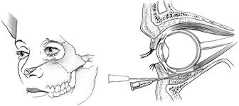
Retroseptal injection

Slide 11
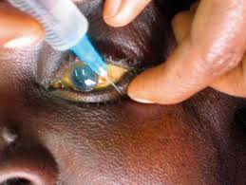
Retroseptal injection

Slide 12
Indications for retroseptal triamcinolone:

Slide 13
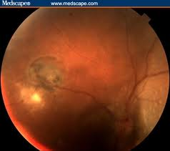
Posterior Uveitis - Caused by toxoplasma, or anything else

Slide 14
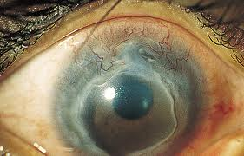
Moreen’s ulcer

Slide 15
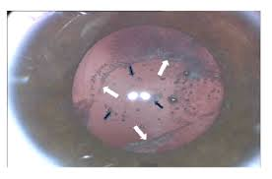
Complicated cataract surgery-after PC rupture or ICCE for dislocated cataract

Slide 16
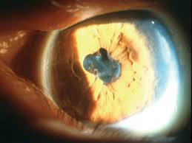
Cataract surgery in patient with uveitis

Slide 17
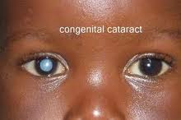
Pediatric cataract surgery

Slide 18
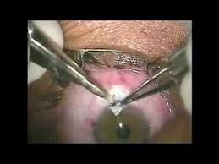
Trabeculectomy or combined SICS/Trabeculectomy

Slide 19
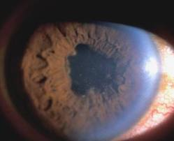
Postoperative uveitis

Slide 20
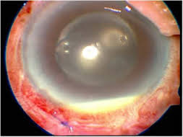
Postoperative endophthalmitis

Slide 21
Contraindications for retroseptal use
Known steroid responders
Patients with poorly controlled, advanced or end-stage glaucoma
Herpes Simplex stromal keratitis or keratouveitis – without added Acyclovir the epithelial disease can reactivate

Slide 22
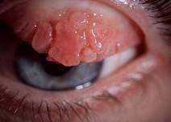
Indications for subconjunctival and/or supratarsal injection - For stage IV allergic conjunctivitis

Slide 23
Subcutaneous use
For chalazion
For keloids
For any kind of scar tissue
Be aware: It might cause skin depigmentation in black people

Slide 24
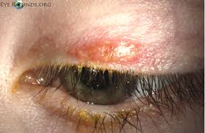
For chalazion

Slide 25
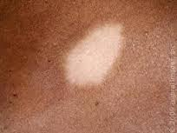
Depigmentation

Slide 26
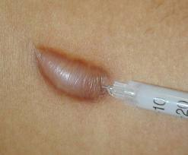
Keloid injected with Triamcinolone

Slide 27
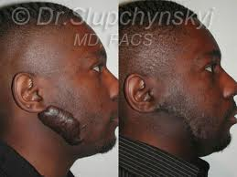
Keloid before and after Triamcinolone injection

Slide 28
Chlorpromazine in place of Retrobulbar Alcohol for the Management of the
Painful Blind eye

Slide 29
Chlorpromazine
A major tranquillizer and antiemetic
Easily available, covered by NHIS
Kills the pain fibers and the optic nerve
Works about 80% of the time
Effect can wear off in a few years, can be repeated
In studies it is shown to be similar or more effective than alcohol

Slide 30

Chlorpromazine injection

Slide 31
Mode of administration
Injection is 25mg/cc, 2 cc vial
Mix with 2cc of 2% Lidocaine and 2cc of Dexamethasone
Give the 6cc mixture retrobulbar
Give cycloplegics, steroid eyedrops and pain-killers for a week

Slide 32
Warn patient:
Sight will NOT return !!!
Remaining small vision will be lost !!!
Pt will be sleepy for 2 hours – give only if with relative, let PT sleep outside the clinic or go home fast
Will have swelling of lids and conjunctiva for a few days
Pain will wear off in 1-2 weeks

Slide 33
Side-effects
Severe periocular inflammation
Resolves in 2-3 weeks, reassure patient, can give po steroids

Slide 34
Consent form
Important to get – PT might get upset about vision not returning
MAKE SURE YOU INJECT THE CORRECT EYE!!!

Slide 35
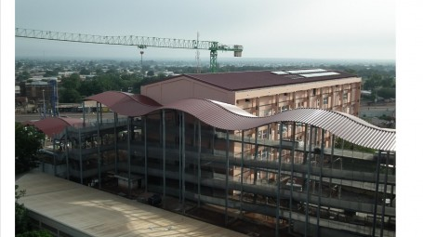
Thank you for your attention!

