Slide 1
AADI –
Aurolab Aqueus Drainage Implant
Judith Simon MD
Ophthalmologist
Tamale Teaching Hospital

Slide 2
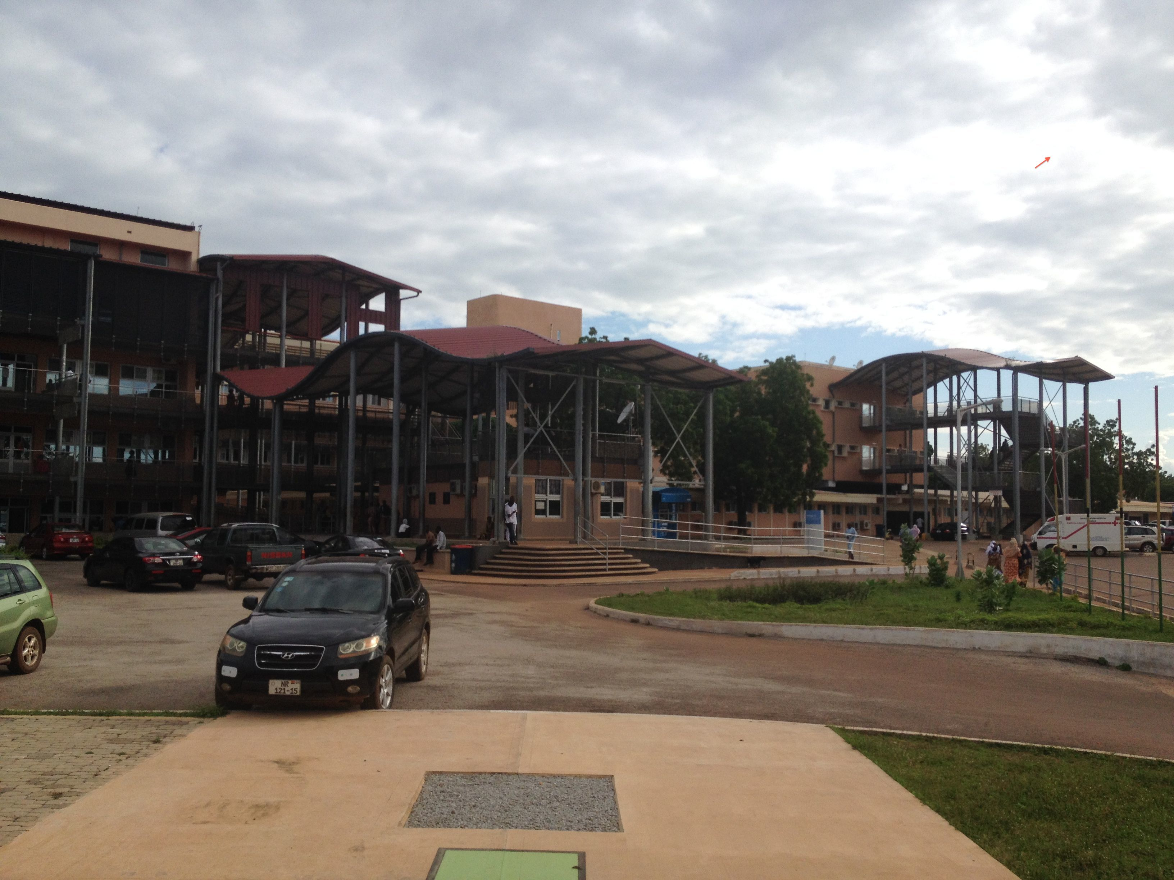
Tamale Teaching Hospital

Slide 3
Objectives:
Concept of tube glaucoma surgery
Types of tubes
Indications
Tube vs Trabec study
Instruments/supplies needed
Surgical technique
Postoperative course
Short and long-term complications and their management

Slide 4
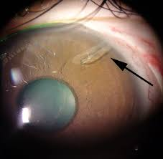
Tube in eye

Slide 5
Tube Glaucoma Surgery
Basic design: A silicone tube drains aqueus fluid from AC to a fibrous capsule surrounding a synthetic plate placed at the equator of the globe. The capsule is the reservoir for aqueus drainage.
It takes 4-6 weeks for the capsule to develop.

Slide 6
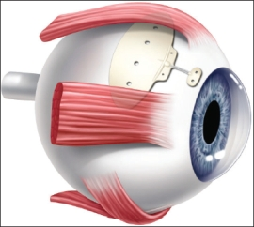
Place of AADI on globe

Slide 7
Drainage implants
Clinical trials started in 1969 for Molteno
Have been available for over 40 years
Several different designs:
  Non-valved: Molteno, Baerveld, AADI
  Valved: Ahmed

Slide 8
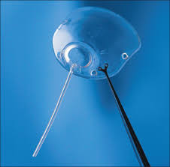
Molteno

Slide 9
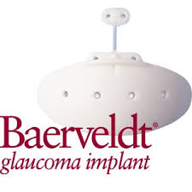
Baerveldt

Slide 10
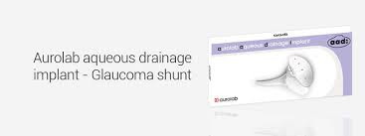
AADI

Slide 11
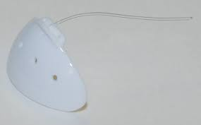
AADI

Slide 12
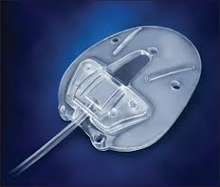
Ahmed

Slide 13
Patient selection
Failed trabeculectomy
After SICS
Congenital/developmental glaucoma
Traumatic cataract with angle recession
Uveitic glaucoma
Aphakic glaucoma
NVG
Post-PK

Slide 14
Tube versus Trabeculectomy study
https://www.ncbi.nlm.nih.gov/pubmed/22245458
Finished in 2007, 5-year f/u in 2012
17 centers, over 200 adult PTs enrolled
Compared Baerveld tube (similar to AADI)
to trabec with Mito 0.4 mg/cc x 4 min
PTs had failed trabec and/or CE

Slide 15
Results at 5 yrs Tube vs Trab
IOP 14.5 vs 12.5
Number of gl meds 1.4 vs 1.2
Failure 30% vs 47%
Reoperation 10 % vs 30%
Complication rate comparable
Quality of life comparable
Can we extrapolate to our population???

Slide 16
Primary tube vs trab ???
Moorfields was planning a study in Ghana
Not done yet because of burocratic challenges

Slide 17
Instruments needed
SICS set
Muscle hook
Caliper

Slide 18
Supplies needed
5-0 , 6-0 or 7-0 Vycril – to tie tube
7-0 or 8-0 Vycril (or other absorbable sut.) –for corneal traction suture, tube fenestration, suturing patch graft and conjunctiva
7-0 or 8-0 silk or prolene – to suture plate
23G needle – to make entry to AC
Preserved sclera or cornea – not a must

Slide 19
Video about AADI technique
Look for Baerveld implantation
https://www.youtube.com/watch?v=dPyTsXB4dY4

Slide 20
Pre-opeartive preparation
Make sure PT and family UNDERSTANDS need and purpose of surgery!!!
Give detailed info in writing
Avoid PTs who do not understand the need/concept – they will be dissatisfied and will scare away others
Stress the possibility of failure and need for 2nd surgery
Tell PT re: the need for gl drops at least for 2 months postop or maybe longer

Slide 21
GLAUCOMA SURGERY CONSENT FORM
You have a disease called glaucoma. This occurs when the pressure inside the eye becomes high. It causes the small blood vessels in the back of the eye to become closed so the blood cannot get to the optic nerve, which is the wire connecting your eyes to your brain. The damage that has occurred to your eyes cannot be reversed and it will worsen until you go blind unless we can lower your eye-pressure. We tried to treat you with eye drops but they do not lower your eye pressure sufficiently. There is an operation that can be done in an effort to reduce the pressure in one of your eyes. This is the best possibility for stopping or slowing down the loss of your eyesight. Without the surgery you are going to go completely blind soon. THE SURGERY WILL NOT MAKE YOU SEE ANY BETTER; IT WILL JUST PREVENT YOU FROM GOING BLIND. During surgery we create a small hole from inside the eye to underneath the white part of the eye called conjunctiva. The fluid will drain out of your eye through the hole. There is no pain during surgery, and you might have some discomfort afterwards for a few days but you will not have severe pain. The surgery is successful only 4 out of 5 cases but if we do not do the surgery, you will go blind for sure. Sometimes the surgery may make your vision worse at the beginning, but it is better than doing nothing in your case. The surgery can have complications once in a while and these might need to be treated by a second surgery. You will need to use drops after surgery for 2 months. If it is successful, very likely after this you will not need eye drops, but there is a small chance you still will. If you have health insurance the operation is free. The medicines for it cost 40 GhC. Please, do not go to a traditional healer, he will spoil your eye.
Please, think about the glaucoma surgery and let us know if you wish us to do it. Also please let us know if you have any questions.
I understand the above and I am consenting to the glaucoma surgery in my RIGHT LEFT eye.
Name:……………………………………………….. Date: ……………...

Slide 22
Patient selection
Avoid phakic eyes with shallow AC – tube will touch either cornea or lens

Slide 23
Pre-op preparation
Continue glau drops till day of surgery
No dilation or Pilo needed
Give retrobulbar or peribulbar block
If more practice, can be done with subconj anesthesia

Slide 24
Surgical technique
Write summary about steps, also about supplies needed, put it on wall next to microscope
Watch video a few times before the day of surgery

Slide 25

Surgical technique

Slide 26
Steps of surgery
Tie tube at plate w 6-0 or 7-0 vycril
Check if it is watertight with NS syringe on AC canula
Corneal traction suture 7-0 vycril
90 deg peritomy 12-3pm, relaxing inc
dissect back, cautery
Isolate SR 7.7 mm and LR 7 mm
Slide plate under them
Suture plate x2 at eyes back at least 10 mm from limbus with nonabsorb, 8-0 silk or prolene.
Cut tube bevel up 30 deg– 1-2 mm into eye
Cut down on sclera 2/3 depth w blade parallel to limbus 5 mm back
Sideport
Stick 23g Needle into AC, parallel with iris, through TM
Bend needle if necess
Thread in tube by holding the scleral inc
Push on cornea to see if the tubes moves – should not!
Leave kink, suture down w nonabsorb
Fenestrate w vycril x2, leave weck of vycryl inside
Cover tube w sclera or cornea
Suture conj with 8-0 or 7-0 Vycril – not necess to be watertight

Slide 27
Placing tube behind iris
Sometimes tube ends up there anyway
OK to leave only in pseudophakic patients – no danger of corneal touch
Make sure it is visible through pupil – leave it longer

Slide 28
Patch graft
Tube has to be covered to avoid exposure up to 5 mm behind limbus
Can use:
  Cornea
  Sclera
  Thick amniotic membrane
  Pericardium
  Dura mater

Slide 29
Alternatives to patch graft
Can start scleral tunnel with 23G needle at least 5 mm behind limbus
Tube will be inside sclera
Very difficult to do – tube frequently ends up behind iris

Slide 30
Alternatives to patch graft
Place tube under a narrow scleral tunnel made with crescent blade started 5-8 mm behind the limbus
Place tube under a scleral flap – similar to trabeculectomy flap but longer
More difficult to thread in tube
Faster and cheaper

Slide 31
Video about scleral tunnel with crescent blade
https://www.youtube.com/watch?v=pTpI4LVz-gQ

Slide 32

Video about scleral tunnel

Slide 33
Postop course
Tube opens up only in 2 months – when suture which tied it absorbs
PT may come with mild uveitic symptoms
Very high IOP immediately postop is prevented by tube fenestration
PT might need glau drops till tube opens

Slide 34
Complications - immediate
Shallow AC / Hypotony
Conjunctival dehiscence
Hyphema
Scleral perforation
Tube blocked by blood clot, fibrin, iris, vitreous

Slide 35
Shallow AC / Hypotony:
From incomplete tying of tube or from leakage around the tube
If not severe, refill with Hylauronate or just wait
If severe and/or persistent, retie tube and place permanent sutures to sclera at tube entry
Can inject trypan blue to AC to see where the leakage is coming from

Slide 36
Complications - late
Tube erosion
Extruded tube with infection
Endophthalmitis
Migration of tube and/or plate
Corneal decompensation (tube touches corneal endothel)
Cataract (tube touches lens)
Overhanging bleb
Diplopia

Slide 37
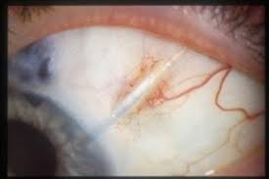
Tube erosion

Slide 38
Tube erosion
If there is no infection yet, it has to be repaired ASAP– cover it again with patch graft and conjunctiva

Slide 39
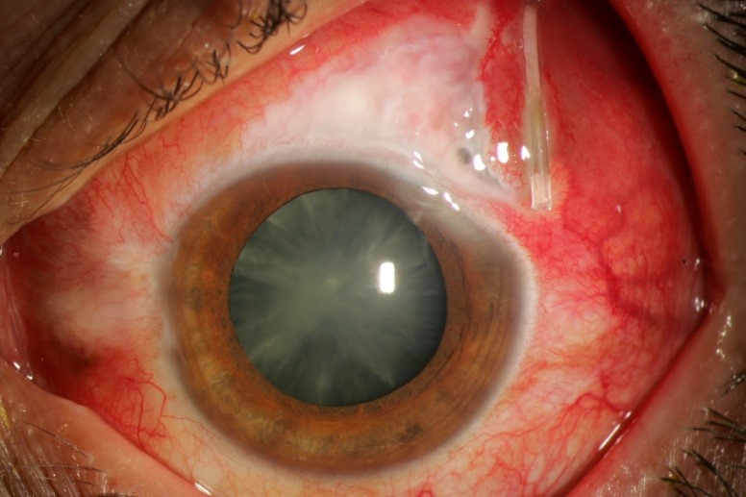
Extruded tube with infection

Slide 40
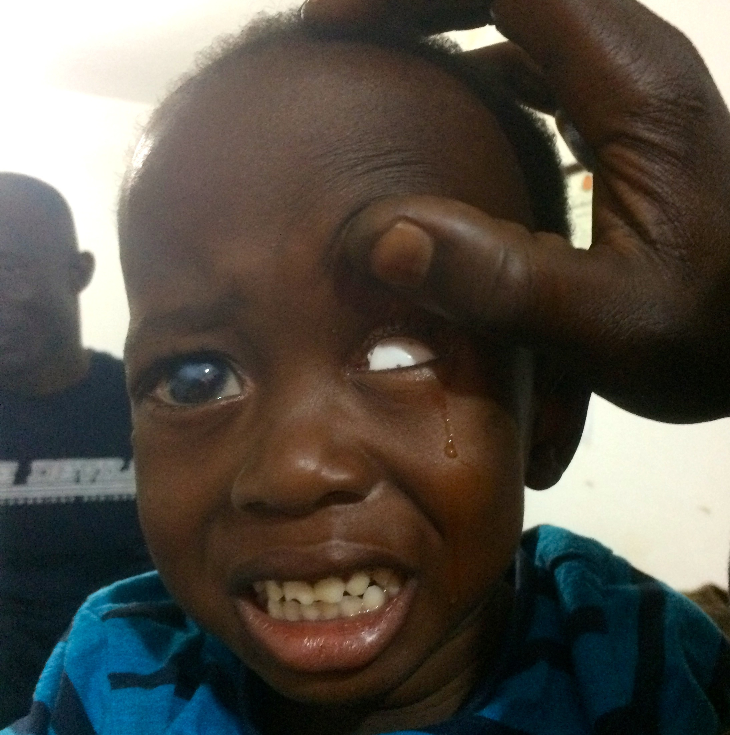
Extruded tube

Slide 41
Extruded tube with infection
Remove tube promptly
Intensive topical and subconj abx,
if already endophthalmitis, intravitreal abx

Slide 42
Endophthalmitis
Treat it same as postop
Tube must be removed!

Slide 43
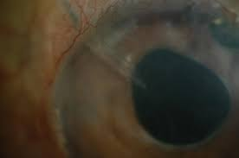
Corneal decompensation (tube touches corneal endothel)

Slide 44
Corneal decompensation (tube touches corneal endothel)
Reposition tube or just cut it shorter
Do it before irreversible corneal decompensation happens!

Slide 45
Cataract (tube touches lens)
Remove cataract from temporal incision

Slide 46
Tube versus Trab: Advantages
Better after failed trab
Better in pseudophakic, aphakic, traumatic and uveitic glaucomas
Probably better in congen/juvenile gl
May be better even as 1st gl surgery
No frequent f/u needed – good for outreach/pts who live far and not able to return

Slide 47
Tube versus Trabec: Disadvantages
Surgery lasts longer, more complicated
Takes 2 months for IOP to drop
Device is expensive (80$)
No experience in managing complications

Slide 48
Summary
Tube surgery is useful as an alternative to a 2nd trabeculectomy
Might be better than trab even as primary glaucoma procedure!
Minimal f/u needed
Useful to learn and do – to give better care for our glaucoma patients!

Slide 49
Combined SICS Trabec video
https://www.youtube.com/watch?v=1JzBrMmgmzk
https://www.youtube.com/watch?v=hvY2sJcq0Tw

Slide 50
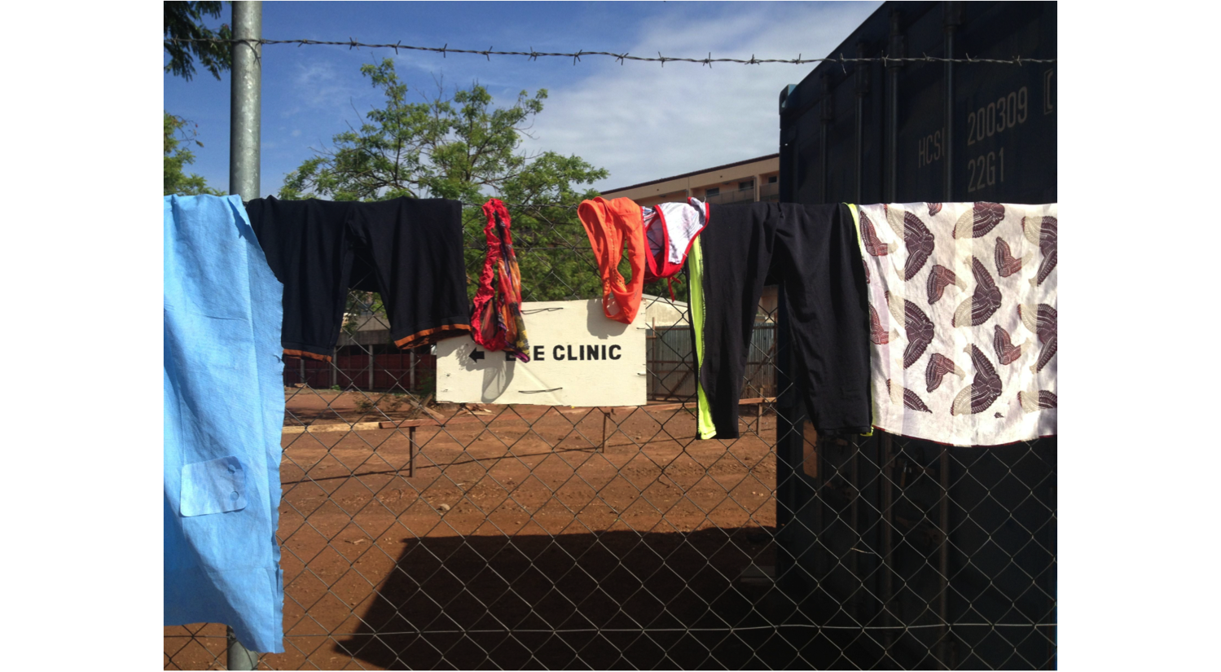
Thank you!

